Slide 1

RAPA | 2017 Spring Meeting
March 28, 2017

Slide 2
Agenda
1:00PM – 3:00PM
  Welcome and Introductions [Greg LaRochelle, Chair]
    Organization Update [Greg LaRochelle]
    Financial Report [Greg LaRochelle]
    Communications/Website [Karen Rotondi]
    Planning [Kelly Priest]
    Initiatives Updates [Eddie Martinez, Vice-Chair]
      Post Level Term [Eddie Martinez for BP]
      Risk Management [Lynn Martone, Lead]
      Education [Dalia Khoury, Lead]
      Data Initiative [Rhonda Nielsen-Jackson]
      Brainstorming on new initiatives
    Committee and Initiative breakout sessions [All Attendees]
    Committee and Initiative reports [Kelly, Dalia, Lynn, Rhonda]
3:00 Adjourn Day
Notes:
2

Slide 3
Antitrust Statement
The Association makes no warranties as to the accuracy of the information contained in discussion forums, meeting minutes or presenter materials. The posting of messages, meeting minutes or presentation materials does not constitute knowledge, endorsement or approval by the Association, nor do we accept any liability for the content of any posting. Individuals using these discussion forums do so at their own risk and shall also remain individually responsible for their actions and statements in using these discussion forums. Because the Association is committed to adhering strictly to the United States and Canada antitrust, copyright, trademark, securities and other federal statutes, as well as state or provincial common laws covering libel, slander, defamation, false advertising, invasion of privacy and violations of the rights of publicity, we strongly discourage users of our discussion forums or attendees of our meetings from verbally stating or writing anything that (1) sets or controls prices or terms of products or services and the manners in which products or services are sold; (2) violates the proprietary or personal rights of others; or (3) constitutes an advertisement. Your use of or participation in Association discussion forums or meetings is acknowledgement of your agreement with the above and your promise to use these forums in a professional and courteous manner.

Slide 4
Executive and Initiative Chairs
  Greg LaRochelle – Chair
  Eddie Martinez – Vice-Chair
  Kim Langstaff – Past Chair
  Garfield McIntyre – Treasurer
  Genevra Pflaum – Secretary
  Kelly Priest – Planning Chair
  Karen Rotondi – Communications Chair
  Susan Whitehead – Membership Chair
  Rhonda Nielsen-Jackson – Data Initiative
  Dalia Khoury – Education Initiative
  Lynn Martone – Risk Management Initiative
  Brittainy Pratt – Post Level Term

Slide 5


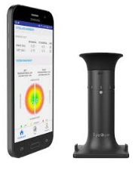
Innovations on the rise…
“Smellovision” – TV, mobile phone
  People can choose between having the smell of bacon or
  coffee to wake up to in the morning, from their phone
GoodSam – life saving app
  Makes people with first aid training aware if you are in the vicinity and have a problem
Crowd Aware Billboards – “I see you”
  Billboards will be able to broadcast content based on data from facial-recognition technology that enables them to identify the gender and age of viewers. Talk about relevant advertising!
The smart dog collar – track where Fido is
  More than location and activity tracking, the collar is designed
    to secure and strengthen the bond between dog and owner.
Do-it-yourself eye exams – who needs an optometrist
  Via a smartphone app and a optical device that connects to the app. Self-administer a state-of-the-art refractive measurement test from home and order glasses online. Track vision changes over time.

Slide 6
Membership
Current Membership
  133 Rapa Members
  2017 Initiative: Reach out to non-member companies!
New Membership Package
  Marketing tool for RAPA.
  Implementation date: March 1, 2017
Geographic Distribution | 2016 | Industry Channel Distribution | No. of Members 2015 | No. of Members 2016 | 2016
Australia | 1% | Solution Provider/Association | 9 | 13 | 10%
Trinidad | 2% | Retrocessionaire | 9 | 7 | 5%
Canada | 35% | Reinsurer | 47 | 56 | 42%
U.S.A | 62% | Direct Writer | 35 | 57 | 43%
Total | 100% | Totals | 100 | 133 | 100%

Slide 7
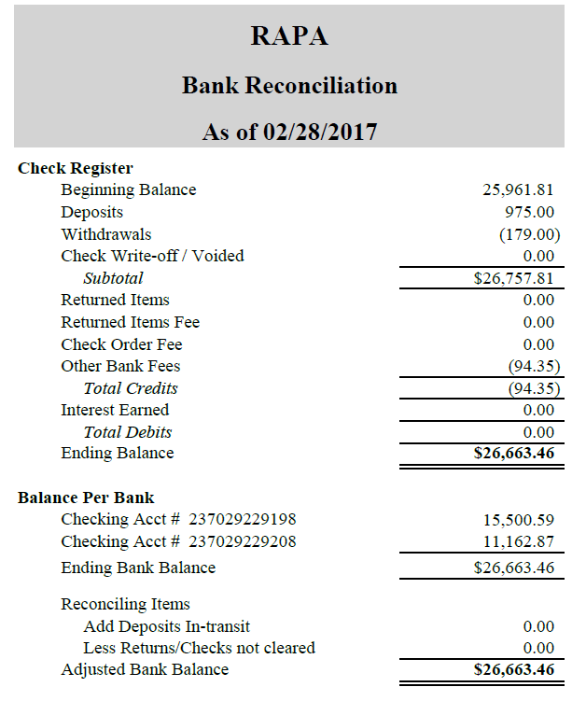
Treasurer's Report
Healthy Balance which remains stable y-o-y
Robust Due Diligence
  Budget
  Cash Management
  Financial Statements
Completed IRS 990N filing for the association

Slide 8



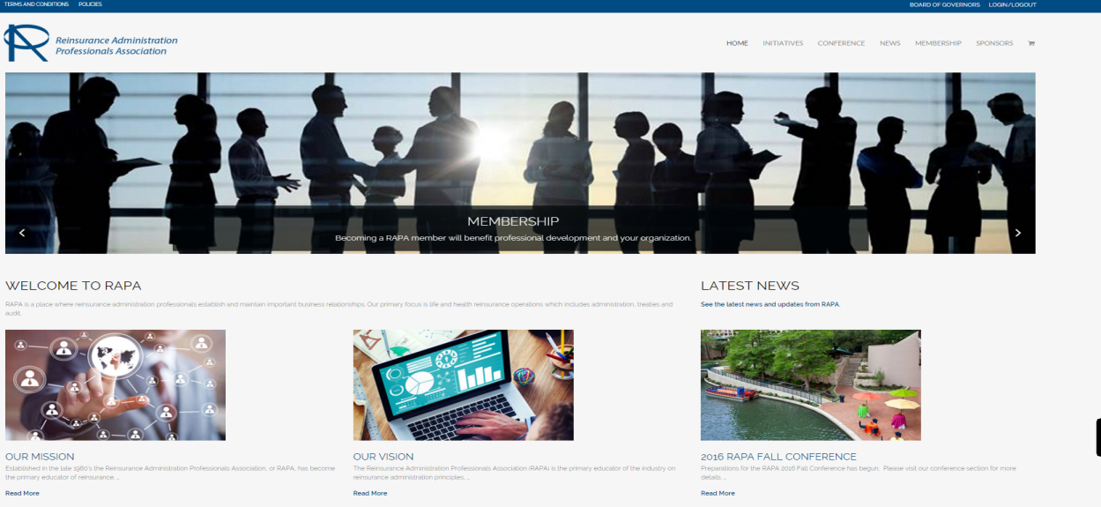
Communication Committee
Website
  Fully functional with on-going improvements
  RAPA content continues to be updated – check back frequently
  Links to social media
Webinars
  TBD
  Education sessions
  Content updates

Slide 9


Annual Conference
Join us in celebrating RAPA’s 20th Anniversary in St. Petersburg, Florida
  Sunday, October 22nd – Tuesday, October 24th
  The Vinoy Renaissance Resort & Golf Club
  501 5th Avenue N.E.
  St. Petersburg, FL 33701
  For reservations visit our website:
  ReinsAdmin.org
  Reservation Toll Free #: 1-888-789-3090
  Use group code:
  “RAPA 2017 Fall Conference”
  Register online today!

Slide 10
Annual Conference - Agenda
Conference Presentations (to date)
Designing the Future of Insurance with Open Collaboration &
Innovation
  Sven Roehl, Executive Vice President, msg global solutions Canada, Inc.
Fraud and International Claims
Kevin Glasgow, 2nd Vice President, Claims, Munich American Reassurance Company
Treaty Trends & Issues
Stephen Cooley, Chief Administrative Officer, Aurigen Reinsurance Company
Goodness & Giggles
Aastal Lal, Founder
Round Table Discussion Groups
Hosted by Industry Experts

Slide 11
Sponsorship Packages
Platinum: $3,000
Free registration for three attendees from your company
Free one-year RAPA Membership for one member
Company Logo displayed at one evening event
Recognition of Sponsorship/Logo on website
Gold: $2,500
Free registration for two attendees from your company
Free one-year RAPA Membership for one member
Company Logo displayed at lunch or one breakfast event
Recognition of Sponsorship/Logo on website
Silver: $1,500
Free registration for one attendee from your company
Company Logo displayed at the Breaks
Recognition of Sponsorship/Logo on website
Bronze: $1,000
Recognition of Sponsorship/Logo on website

Slide 12
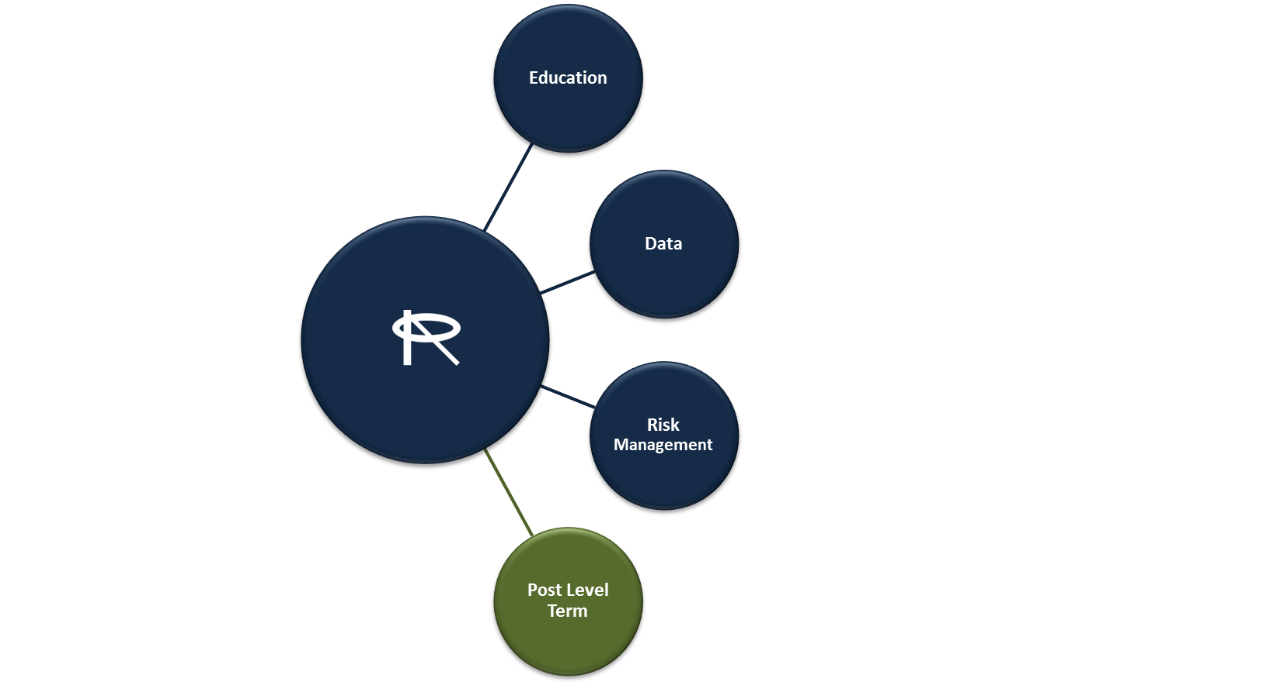
Initiatives Strategy
Purpose: To improve the effectiveness and efficiency of RAPA member's reinsurance understanding and processes. The initiatives work streams provides the opportunity for members to work together on education, training, and to benefit from robust collaboration with industry experts within the working groups.
Thinking of a new initiative?
Submit your suggestion to Greg LaRochelle [greg.larochelle@rbc.com] or Eddie Martinez [Edgar.Martinez@axa.us.com]
Want to join an Initiative? Just contact one of the leads
Education: Dalia Khoury, Optimum Re
Dalia.Khoury@optimumre.com
Data: Rhonda Nielsen-Jackson, Hannover
Rhonda.Nielsen-Jackson@hlramerica.com
Risk: Lynn Martone, Swiss Re
Lynn_Martone@swissre.com
Post Level: Brittainy Pratt, Logic3
Brittainy.pratt@logic3.com
Notes:
Per Slide

Slide 13
Post Level Term
Host discussions around Post Level Term administration to gain industry insight and capture Best Practices.
Explore, research and write a white paper to document Post Level Term challenges best practices
Established four sub-groups to categorize and address challenges:
  Administration and Processing
  Communication
  Finance
  Emerging Trends
Prepare a Post Level Term presentation to share at a RAPA Fall Meeting and other industry events.
Notes:
Version 2 updates – speak to additional information from GP
Speak to updates in version 3
Version 2 contains 3 new sections in Reporting Issues:
Changes in Policy Number: Conversions, exchanges, system changes (system conversion) that policy numbers are updated. Term changes to a new Term products….policy upgrades. Proactive communication to your business partners…use the form that was previously recommended. If it’s not logical then a cross tab should be provided to map to the new number.
Inforce and Transaction Not Reconciling: Timing issues, system upgrades, special adjustment/enhancements…mitgating best practice validation and reporting/reconcilition prior to reporting, communicating proactively implement a formal reconciliation process. Receiver should ask questions asap to mitigate any larger issues….
Partial Reporting: System errors with processes not run at the same time…some of the content changes and not validated causes a shift in the data then it can be corrupted leading to a delay in reporting. Scenario where something is wrong with the file and don’t know if something is incorrect. Best Practices – Validation that all files are complete and this type of review should be done by all parties. Monitor changes made on admin system and ensure data is consistent/communicated to your business partner. Recipient should communication any anomalies immediately to the sender.

Slide 14
PLT - 2017 Areas of Focus
Finalize outlines
Utilize completed outlines to complete PowerPoint and White Paper
Continue hosting industry discussions to ensure best practices are captured in final documentation

Slide 15
Risk Management Initiative
Purpose
The RAPA Risk Management initiative team works to develop tools and techniques related to risk identification,
assessment and mitigation, as well as assessing audit and compliance reviews of the reinsurance administration
function. The key goal is to provide common reinsurance guidelines and methodology approaches for direct
writers, reinsurers and retrocessionaires.
This initiative is divided into two sub-teams with focus on:
Reinsurance Administration Risk Assessment
Reinsurance Administration Audit and Compliance Reviews
Deliverables & Milestones
Risk Assessment; the Risk Assessment sub-team has developed a risk assessment matrix detailing and defining
strategic, operational and compliance risks. Our 2016 areas of concentration included:
  Strategic Risk – Mergers & Acquisitions, Business disruptions, Sox Controls
  Operational Risk – Training and development, processes and procedures, organizational structure,
  succession planning
  Compliance – Non Compliance; FATCA, Anti Money Laundering, OFAC, Fraud
2. Audit & Compliance Reviews; the Audit & Compliance sub-team has identified what criteria should be used when
selecting audit candidates. Our 2016 areas of concentration included brainstorming the following approaches:
  Kick off a high level deep dive into specific audit topics such as, conversions, retention management, joint
  lives, post level term
  Agree to identify best practices
  Discussed developing white paper/catalogue of auditing practices to be shared with the industry
Notes:
2 initiatives –
i) Operational Risk Management initiative – focus on risk management assessment tool to help reins admin function on a systematic basis. Tool to identify key risk to the function and how it leads to risk mitigation. How to quantify will be different likely hood, impact, etc. Tool to use for your own organization.
ii) Audit Compliance sub team – taking a focus on the audit process to put together the flow chart to ensure quality assurance. The annual risk assessment process, timeline, steps, and tools that direct clients could use to build out their own audit program. Operational Risk book has a lot of information and role it into other initiatives as it develops. Identification of key risks, coming up with qualitative and quantitative measures and identifying which treaties you would want to assess for those controls. Selection Criteria…based on aggregated results. What are road blocks….clients wont show their “hand”. Lessons learned….instead of leveraging current framework.

Slide 16
Risk Management Initiative
Deliverables for 2017
Risk Assessment
  Continue with deep dive into remaining sub-risks identified as in scope
  Specifics to be presented at the 2017 RAPA conference
Audit & Compliance
  Continue with deep dive in order to publish white paper
  Deep Dive and Define:
    Pre audit prep
    Onsite audit review
    Post audit communication
  Please feel free to contact Lynn Martone or Amalia Figueiras
  should you have any questions or would like to join our team.
Members:
Lynn Martone, Swiss Re
Amalia Figueiras, Prudential
Laura D’Andrea, Prudential
Garfield McIntyre, Munich Re
Anthea Cote, Munich Re
Ricky Peterson, Munich Re
Carolyn MacPherson, Swiss Re
Carol Arada, Swiss Re
Jennifer Atlee, Hannover Re
Janice Lawrence, Pac Life
Alan Woodlard, RGA
Sandra Law, SCOR Global Lf
Barbara Beicker, USAA
Kelly Priest, LOGIQ3
Karl Martone, Martone & Martone
Antonio Layne, RBC
Thomas Trent, Transamerica
Kim Langstaff, Hannover Re
Maribet Toledo, Lincoln Financial
Lauren Trondle, Ohio Nat’l

Slide 17
Education Initiative
Purpose
Develop training material presented as a workflow chart for different processing functions and ultimately have case study to illustrate the impact of processing by using the workflow charts.
Target Audience
Rapa Web site
Training material for newbies
Developing Resources
Dalia Khoury, Optimum Re
Ann Grace, Manu Life
Brenda Warner, Canada Life
Deidre Ward, Swiss re
Diana Aversa, Pac Life
Judy Brillert, Canada Life
Julie Dee Faris, CSC
Kim Brabham, Hannover re
Patty Bailey, Manu Life
Vivian Tseng, john Hancock
Notes:
Dalia to speak to

Slide 18

Education Initiative
NEWS FLASH!!
LOMA online courses for
Reinsurance supplement now at a reduced cost of $100!
.
Notes:
Dalia to speak to

Slide 19
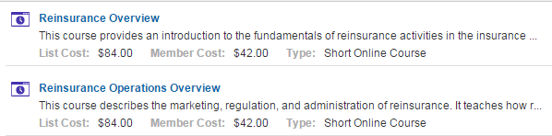
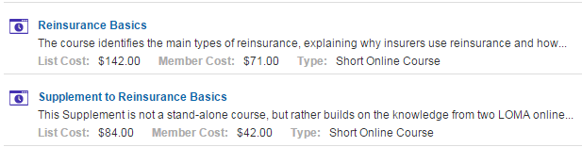
Education Initiative
The new website is www.loma.org, under LOMA LEARNING SYSTEM
http://learning.loma.org/public/SearchResults.aspx?CTGYLCL_CATEGORY_ID=DA28E2A4D4C947DBA225A9752C9C8954&CNTLCL_LOCALE_ID=en-us
In Course Collection

Slide 20

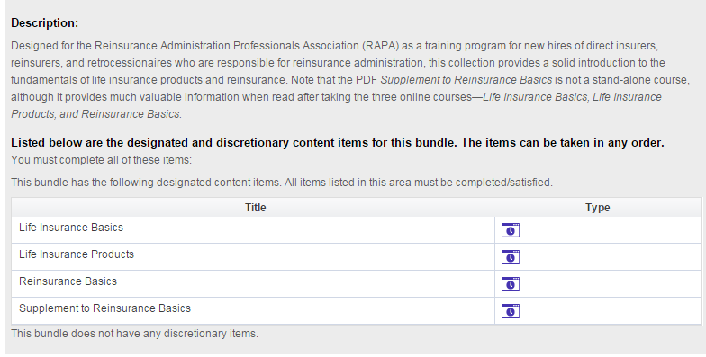
Education- Reinsurance Course Collection

Slide 21
Education

Slide 22
Education

Slide 23
Education

Slide 24
Education

Slide 25
Education Initiative
2017 initiatives
Joint venture with the Data Initiatives group
Explore options of topics that interest the RAPA audience.

Slide 26
Data Initiative Overview
Purpose
Create a document for Guidelines for Reinsurance Reporting, in essence a document of best practices for specific areas of reinsurance administration and data quality.
The document includes information, samples and realistic scenarios. Topics:
  Reporting Issues
  Communication/Notifications
  Data Quality
  Conversions
  Taking a Treaty from paper to system implementation
  Samples of typical reinsurance reporting, i.e. Policy Exhibit, Transaction files, etc
Members
Rhonda Nielsen-Jackson, Hannover Re
Genevra Pflaum, Hannover Re
Ellen Fedorowicz, Jackson National
Saline Smith, Swiss Re
Melinda Bynoe, BMO Reinsurance
Par Kambo, RBC Insurance
Duane Pfaff, ING Re
Diana Aversa, Pacific Services
Grace Sirianni, Munich Re
Eileen Ah-Fat, Canada Life
Karen Lipka, RGA
Michael Barnett, mL3 Global Life
Jeanne Bost, SCOR
Lauren Trondle, Ohio National
Marjorie Tyler Bridges, Scor Re
Melanie Netzer, Optimum Re
Mindy Epstein-Hinshaw, Logiq3

Slide 27


Data Initiative
Deliverables & Milestones
  Version 1 was rolled out at the 2014 RAPA Fall Meeting
  Version 2 was rolled out in April 2015
  Version 3 was rolled out at the 2015 RAPA Fall Meeting
  Version 4 was rolled out in April 2016
  Version 5 was rolled out at the 2016 RAPA Fall Meeting
  Version 6 was completed March 2017 and is currently available on the RAPA website @ http://www.reinsadmin.org under Initiatives and Data Management
  New topics added in Versions 5 & 6 are:
      Conversions- enhanced Conversion Guidelines Matrix
      Reporting issues- Face Increases & Decreases
  Communicating New System, Data or Administration to Business Partners is available on RAPA website and not required to be a RAPA Member to use.
Guidelines
Reinsurance
Reporting
Notes:
Version 2 updates – speak to additional information from GP
Speak to updates in version 3
Version 2 contains 3 new sections in Reporting Issues:
Changes in Policy Number: Conversions, exchanges, system changes (system conversion) that policy numbers are updated. Term changes to a new Term products….policy upgrades. Proactive communication to your business partners…use the form that was previously recommended. If it’s not logical then a cross tab should be provided to map to the new number.
Inforce and Transaction Not Reconciling: Timing issues, system upgrades, special adjustment/enhancements…mitgating best practice validation and reporting/reconcilition prior to reporting, communicating proactively implement a formal reconciliation process. Receiver should ask questions asap to mitigate any larger issues….
Partial Reporting: System errors with processes not run at the same time…some of the content changes and not validated causes a shift in the data then it can be corrupted leading to a delay in reporting. Scenario where something is wrong with the file and don’t know if something is incorrect. Best Practices – Validation that all files are complete and this type of review should be done by all parties. Monitor changes made on admin system and ensure data is consistent/communicated to your business partner. Recipient should communication any anomalies immediately to the sender.

Slide 28
Data Initiative- Recent Work
  Added causes, impacts, best practices and scenarios to document for:
    Face Increases & Decreases reporting for both Contractual and Non-contractual changes
  Expanded Conversion Guideline Matrix to include:
    Exchanges
    Inter-company Conversion
  Other topics being worked on:
    Data Quality- Glossary with field definitions using ACORD and LOMA as guides
    Notifications/Communication – Acquisitions, E & O, Recapture and Retention changes (in final stages before publication)
    Collaboration with Education Initiative team

Slide 29
Breakout Sessions
  Executive
    Greg LaRochelle
  Planning
    Kelly Priest
  Data Quality Initiative
    Rhonda Nielsen-Jackson
  Education Initiative
    Dalia Khoury
  Risk Management Initiative
    Lynn Martone
Notes:
Tom to speak to
29

