Slide 1

RAPA
2015 Fall Meeting
October 19, 2015

Slide 2
Agenda
8:30 – 8:45 Welcome and Introductions
8:45 – 9:45 Obsessed with Data…And for Good Reason
          Moderator – Genevra Pflaum
          Speakers – Evelyn Bradanovich , Lisa Sher, Ellen Fedorowicz
9:45 – 10:15 Break
10:15 – 11:15 Unleash the Power of People
          Speaker – Tonya Blackmore
11:15 – 12:00 Emerging Reinsurance Trends: What are people talking about
          Speaker – Stephen Cooley
12:00 – 1:30 Lunch
1:30 – 2:00 Vote – Board of Governor’s
          Directed By – Shaun Downey
2:00 – 3:30 Roundtable Discussion: Looking for an Oasis in an Operational Desert
          Facilitators – Eddie Martinez, Anthea Cote’, Lynn Martone, Dale Kraus, Susan Gonsalves, Greg LaRochelle
3:30 – 3:45 Break
3:45 – 5:00 Roundtable Discussion: Wrap-up Session
          Speaker – Michael Barnett, Jill Dupuis, Paula Boswell-Breier,
          Sara Murphy
5:00 Adjourn Day 1
6:30 – 9:00 Cocktail Reception & Dinner
Notes:
2

Slide 3
Antitrust Statement
The Association makes no warranties as to the accuracy of the information contained in discussion forums, meeting minutes or presenter materials. The posting of messages, meeting minutes or presentation materials does not constitute knowledge, endorsement or approval by the Association, nor do we accept any liability for the content of any posting. Individuals using these discussion forums do so at their own risk and shall also remain individually responsible for their actions and statements in using these discussion forums. Because the Association is committed to adhering strictly to the United States and Canada antitrust, copyright, trademark, securities and other federal statutes, as well as state or provincial common laws covering libel, slander, defamation, false advertising, invasion of privacy and violations of the rights of publicity, we strongly discourage users of our discussion forums or attendees of our meetings from verbally stating or writing anything that (1) sets or controls prices or terms of products or services and the manners in which products or services are sold; (2) violates the proprietary or personal rights of others; or (3) constitutes an advertisement. Your use of or participation in Association discussion forums or meetings is acknowledgement of your agreement with the above and your promise to use these forums in a professional and courteous manner.

Slide 4
Welcome
Phoenix gets its name from Cambridge-educated pioneer Darrell Duppa, who saw the ruins and prehistoric canals of the Hohokam and believed another civilization would rise from the ashes.
Phoenix is the United States’ sixth-largest city with a population of over 1.4 million.
Greater Phoenix (which includes, among others, the cities of Chandler, Glendale, Scottsdale and Tempe) has a population of nearly 4.3 million and covers 2,000 square miles.
Greater Phoenix is located in the Sonoran Desert, which is one of the wettest and greenest deserts in North America, thanks to 3-15 inches of annual rainfall.
Greater Phoenix has more than 62,000 guest rooms at more than 450 hotels and more than 40 resort properties.
Greater Phoenix is home to more than 200 golf courses.
More than 16 million people visit metropolitan Phoenix each year.
Celebrities who live in Phoenix include Charles Barkley, Alice Cooper, and Muhammad Ali.

Slide 5
Executive and Initiative Chairs
  Greg LaRochelle – Chair
  Shaun Downey – Past Chair
  Kim Langstaff – Treasurer
  Susan Whitehead – Secretary
  Stephanie Williams – Planning Chair
  Karen Rotondi – Communications Chair
  Genevra Pflaum – Data Initiative
  Dalia Khoury – Education Initiative
  Garfield McIntyre – Risk Management Initiative

Slide 6
RAPA Organization update
  Membership – 117 members
  Fall Conference – 105 attendees
  Website Improvements
    Payments online: Conference Registration, Membership Renewals
    Social Media: Facebook, Twitter, LinkedIn
    Initiative updates + material online

Slide 7
Treasurer's Report
Reinsurance Administration Professionals Association
2015 Treasurer's Report as of October 14, 2015 |  |  | Totals US$
Balance forward from April 8, 2015 |  | $ 28,742.78 | $ 28,742.78
Total Credits |  | $ 52,832.04 | $ 81,574.82
Total Debits | $ (20,906.04) |  | $ 60,668.78
Ending Balance as of October 14, 2015 |  |  | $ 60,668.78
Income
Deposits - Membership fees |  | $ 2,852.04 | $ 2,852.04
Deposits - Transfers from Deposit Account to Checking Account |  | $ 10,000.00 | $ 12,852.04
Deposits - 2015 RAPA Conference fees |  | $ 32,480.00 | $ 45,332.04
Deposits - 2015 RAPA Sponsorships |  | $ 7,500.00 | $ 52,832.04
Expenses
Bank Account Fees (credit card processing and monthly maintenance fees) | $ (1,649.75) |  | $ (1,649.75)
Reimbursement for Spring Meeting Lunch (Pac Life) | $ (1,367.25) |  | $ (3,017.00)
RAPA Website updates | $ (2,540.00) |  | $ (5,557.00)
Transfer from Deposit Account to Checking Account | $ (10,000.00) |  | $ (15,557.00)
Reimbursements (overpayment of membership/conference fees) | $ (349.00) |  | $ (15,906.00)
2015 Conference Hotel Deposit Marriott Buttes - Phoenix, AZ | $ (5,000.00) |  | $ (20,906.00)
Totals | $ (20,906.00) | $ 52,832.04 | $ 60,668.78
Less known future credits and debits:
2015 RAPA Conference fees to be paid |  | $1,050 | $ 61,718.78
Aurigen Re 2015 Sponsorship |  | $2,500 | $ 64,218.78
Munich Re 2015 Sponsorship |  | $2,500 | $ 66,718.78
Speaker Gifts/Door Prizes | $ (820.90) |  | $ 65,897.88
Refunds for Conference fees | $ (750.00) |  | $ 65,147.88
2015 Registered Agent Fee | $ (149.00) |  | $ 64,998.88
Balance due for website upgrades | $ (2,635.00) |  | $ 62,363.88
RAPA Monthly Website Maintenance Fee (October 2015) | $ (95.00) |  | $ 62,268.88
Estimate for remaining hotel conference fees | $ (35,000.00) |  | $ 27,268.88
Estimated Balance after additional costs |  |  | $ 27,268.88
Created By: Kim Langstaff
Treasurer

Slide 8

Reinsurance Administration
Professionals Association
(RAPA)
Obsessed with Data…And for Good Reason

Slide 9


Data Quality: Obsessed with Data… And For Good Reason
An interactive discussion about the impacts of high quality and poor quality data.
Focuses on best practices.
BONUS: RAPA members have created a handy reference doc for best practices and guidelines for data and reporting!
RAPA 2015 Fall Conference

Slide 10
Presenters:
Genevra Pflaum, AVP, Client Data at Hannover Re
  Overview and general impacts of poor quality and high quality data across an organization
Evelyn Bradanovich, AVP, Operations at Pacific Services Canada Limited
  The challenges and impacts of late reported business
Lisa Sher, Manager, Data Load at SCOR Global Life Americas
  Impact of missing key fields
Ellen Fedorowicz, Reinsurance Manager at Jackson National Life Insurance Company
  CONVERSIONS!
RAPA 2015 Fall Conference

Slide 11
One Source of Data for All
Treaty
Products
Actuarial
Mgmt.
In Force
Mgmt.
Finance
Marketing
Claims
UW
RAPA 2015 Fall Conference

Slide 12


DATA
ANALYSIS
KNOWLEDGE
DECISIONS
PLANNING
Your
Analysis
Knowledge
Decisions
Planning
is only as good as your DATA

Slide 13
Inaccurate Experience
POOR QUALITY DATA
Incorrect Assumptions
Imprecise Reserving
Volatility in Financials
RAPA 2015 Fall Conference

Slide 14

Administration/Underwriting
TIME spent researching, tracking, cleaning, reconciling.
Communication is critical.
Modeling
Actual vs Expected – why is it so skewed?
Post Level Term tracking.
Valuation
Is this variance real or because of a data error?
Bad data equals incorrect reserves.
Experience Studies
Consistency is key.
Mortality assumptions affect pricing.
RAPA 2015 Fall Conference

Slide 15
RAPA
Post Level Term
Accurate Identification
Lapse/Persistency Analysis
Premium Validation
Correct data points
Due diligence
Best Practices
Communication
Quality checks
RAPA 2015 Fall Conference

Slide 16
Data has a direct impact on decision making processes
Data feeds profitability management
Poor quality data creates inefficiencies and extra work within a process or department
RAPA 2015 Fall Conference

Slide 17

Late Reported Transactions
Evelyn Bradanovich
AVP, Operations
Pacific Services Canada
RAPA 2015 Fall Conference
Notes:
What I want to talk about today is late reported data. This could cover many types of transactions but I will focus on new business and terminations, as these are usually the highest volume and therefore will have the biggest impact.

Slide 18
Why does this happen?
Mergers and Acquisitions
  Records may not be available or may be unclear
No link between direct/ceded or assumed/ceded systems
Manual ceding processes/poor controls
New product, no system support
Delayed treaty resolution
RAPA 2015 Fall Conference
Notes:
There are a number of causes for this which include:
M & A activity – cedants are inheriting business from acquired companies, sometimes without any of previous staff. Perhaps no knowledge of underlying business or systems.
Another reason: Sometimes difficult to get funding for ceded operations, some companies have manual processes, poor controls resulting in higher error rates and perhaps missed blocks of business.

Slide 19
Late reported terminations – Impact
Cedant
Financial volatility
Overstatement of reserve credit
Treaty provisions may restrict refund period
Late reported recapture may require refund of claims
Small industry, large block of late reported may affect several players
May trigger reinsurer audit
RAPA 2015 Fall Conference
Notes:
Initial overpayment of premiums, then large refund; paying ceding premiums when no incoming premiums received
Taking a reserve credit for reinsurance that is not valid
If a new policy is issued, it may be ceded unnecessarily as the prior policy may appear to be inforce
Must return moneys for any claims that were paid in error- this would only occur if this was a late recapture
Some treaties have a provision that limits the number of years that a refund may be paid so may not get a full refund
Small industry, when there is a big oversight, most likely affects several players
Could trigger audit

Slide 20
Late reported terminations - Impact
Reinsurer/Retro
Financial volatility
Large premium refund
Reserve impact
Retention impact – could turn down new capacity requests
RAPA 2015 Fall Conference
Notes:
– premiums are being overpaid, then large multi-year refund reported, could trigger a large loss in the year of correction
Reserves overstated, than a big reduction (could go other way too depending on product)
May look to be fully retained as capacity looks filled; maybe insured has cancelled policy and bought new insurance with another carrier; looked for reinsurance and we missed opportunity
Most of us report to parent companies, they expect us to monitor and detect instances of late reporting; not always easy when regular billings are received

Slide 21
Late reported New Business - Impact
Cedant
Financial volatility
Reserve credit is understated
May be over-retained
Treaty provisions may restrict available capacity
May trigger reinsurer audit
RAPA 2015 Fall Conference
Notes:
May have to pay several years of back premiums all in one year, could trigger significant impact on earnings for the year
The cedant is not taking applicable reserve credit for ceded business
Could be over-retained. If fac, may be liable for full amount ;if auto may have treaty limitations if business is older.
May have to pay several years of back premiums; hit on bottom line may be significant
If fac, may not have coverage in event of claim; auto, may be a time limit after which reinsurance is not guaranteed. r/r may be fully committed from another source
Small industry, so if big impact, may effect industry reputation.

Slide 22
Late reported New Business - Impact
Reinsurer/Retro
Financial volatility
Reserve impact
Potential capacity issue – may be over-retained
Impact on financial forecasts
RAPA 2015 Fall Conference
Notes:
premium volatility
Reserves may be over or understated depending on product, then a huge adjustment
May be bound on policies from other sources and not have capacity
May lose credibility with our parent companies – they expect reinsurer to be able to detect these fluctuations
Impact on forecasting;

Slide 23
Case Study
Cedant had many manual assumed systems, not linked
Manual processes, poor controls
Late reported lapses $5M premium refund
Late reported reinstatements $200k
Late reported claims $1M
Large reserve impact
RAPA 2015 Fall Conference
Notes:
A discussion of the potential impact, big impact on reserves too
Our company’s share only, so total impact was much bigger for entire pool

Slide 24
Case Study
Cedant acquired another company
Poor understanding of acquired systems/treaties
Stopped loading assumed data
Late reported new business $4M back premiums; $100M of NAR
Late reported terminations $4M premium refund
Late reported claims $6M
RAPA 2015 Fall Conference
Notes:
Audience discussion of impact; mix of business changed a lot so big impact on reserves as well

Slide 25

Best Practices
Cedant
Robust ceded system with link to direct/assumed system
If no link, ongoing reconciliation between direct system and ceded system
Monitor lapse ratios – do they look reasonable?
Monitor new business volumes
If cedant is reinsurer, regular loading of assumed client data
RAPA 2015 Fall Conference
Notes:
If possible, best solution is to have a link between systems. Not always possible for budget reasons
Alternatively, regular reconciliation between the two. Run reports: are all ceded policies still in force; are all applicable policies on direct systems ceded; regular retention checks
Is it possible to do some reasonability checks; do lapse ratios on ceded look reasonable; do ceded NB volumes look reasonable compared to assumed
Are you loading client assumed files regularly and monitoring delays in loading

Slide 26
Best Practices
Reinsurer/Retro
Regular analysis of seriatim data
Monitor lapse ratios - actual/expected
Monitor NB actuals vs. plan (more difficult)
Client audits
If active recapture program, estimate recaptures, compare to actuals
RAPA 2015 Fall Conference
Notes:
Regular analysis of assumed data
Monitor lapse rates
Etc.

Slide 27
Case Study
Other examples of best practices?
RAPA 2015 Fall Conference
Notes:
Introduce Lisa!!

Slide 28


Electronic Reporting – Missing Data
Lisa Sher
Manager, Data Load
RAPA 2015 Fall Conference
Notes:
Hi my name is Lisa Sher and I am here to talk to you today about Electronic Reporting – Missing Data.
I will touch on Potential causes
Impact of missing data on a more granular level and
Provide some hints on what can be done to improve data quality
So Let’s look at some potential causes

Slide 29
Potential Causes
Key fields not obtained for insured
Key fields not stored in Client Admin System
System conversion – Acquisition or Upgrade
System Limitations – Inability to process all values of key fields
RAPA 2015 Fall Conference
Notes:
Here we see some potential causes where the Direct Writer is not able to obtain insured information or key fields are not stored in the Client Admin system.
The client may have the data but use a third party administrator and the third party may not capture all key fields in their system.
The Direct Writer may have acquired a company or a block of business that had a reporting system that did not gather key fields or not converted over to new system properly
The Direct Writer may have system limitations that prevent them from reporting all values for each field

Slide 30
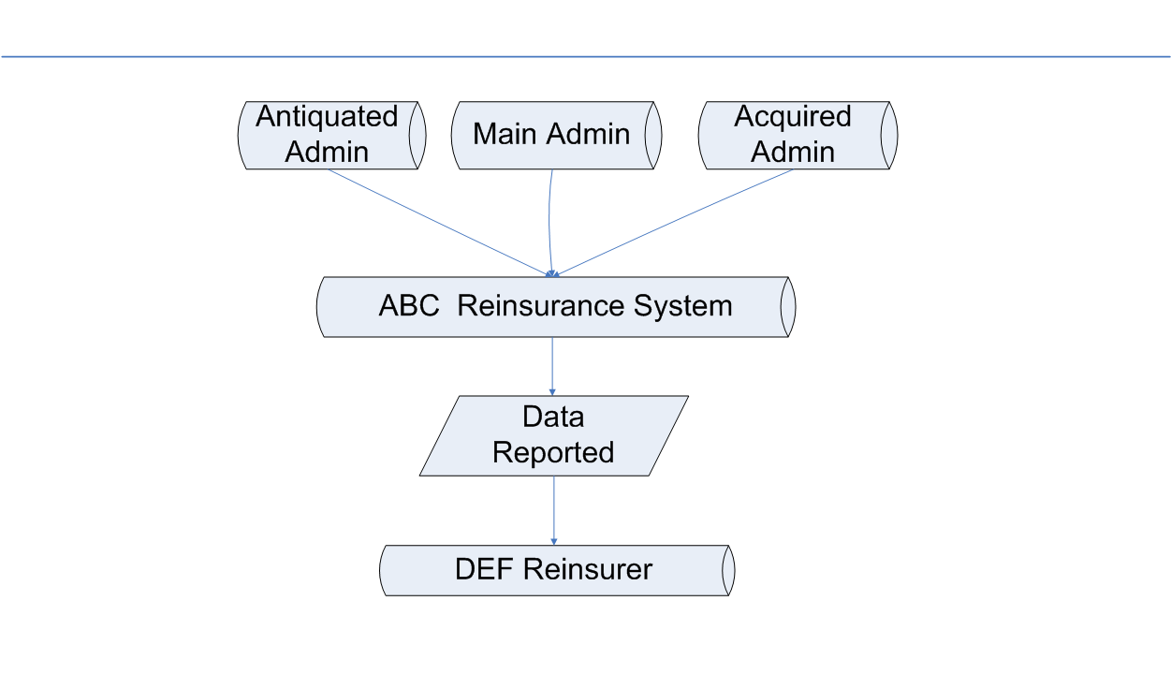
ABC Life System Overview
RAPA 2015 Fall Conference
Notes:
To make it easier to following along on how data is reported to the reinsurer.
Let’s look at this fictitious company ABC Life
Where they have 3 ADMIN systems
Antiquated Admin– Legacy – may not report all values for all fields
Main Admin – reports all fields and field values
Acquired Admin System – Homegrown – may not report all fields
These 3 Admin Systems feed in to their Reinsurance Admin System which then reports data to DEF Reinsurer
Now let’s look at some of this reported data

Slide 31
ABC Life Reported Data
Policy No | First NAME | Last NAME | Pol Type | PLAN | Rating | Risk Basis | Smoker | Face Amount | Net Amount At Risk
0111111 | Amy | Woo | S | T75 | 100 | Std | N | 500,000 | 250,000
020202 | Paul | Jones | S |  | 100 | Pref | N | 1,000,000 | 800,000
333333 | Sandy | Rainer | S | T100 |  |  |  | 750,000 | 400,000
444000 | Joe | Smith | S | T20 | 100 | Std | N | 2,000,000 | 0
555555 | Bruce | Fry | J | ULJ | 100 | Std | N | 1,000,000 | 900,000
RAPA 2015 Fall Conference
Notes:
Here we have 5 records from ABC Life with some of the information that is passed. Of course there is much more information that is passed, but for this discussion lets focus on these fields.
The 1st record is good – all fields are populated and are accurately reported
The next 4 have missing values of key fields
Now let’s look at the impact of each of these records

Slide 32

Treaty Data Impact
Policy No | First NAME | Last NAME | Pol Type | PLAN | Rating | Risk Basis | Smoker | Face Amount | Net Amount At Risk
020202 | Paul | Jones | S |  | 100 | Pref | N | 1,000,000 | 800,000
Treaty placement– Assumed and Ceded
Retention management issues
Claims processing delay
Reserve and financial impact
RAPA 2015 Fall Conference
Notes:
Here you see that the Plan information is missing
If you do not have a plan code you cannot map this record to the physical treaty or to its treaty parameters so this affects treaty placement. Assumed and retro treaty placement.
New Capacity cannot be established because the risk is unknown- over retain on life
If you cannot link the record to the treaty – you can’t pay the claim
If you cannot reserve properly it will lend itself to financial impact.
Lapse assumptions are based on plan
Usually when there is a new deal – new plan codes are created
If the Company has 2 Open Treaties and a record comes in without a plan code, then how do you know which treaty it belongs to?
If only 1 Open treaty is it safe to assume that is the correct treaty? Maybe not.

Slide 33

Underwriting Data Impact
Policy No | First NAME | Last NAME | Pol Type | PLAN | Rating | Risk Basis | Smoker | Face Amount | Net Amount At Risk
333333 | Sandy | Rainer | S | T100 |  |  |  | 750,000 | 400,000
Premium rates and payment
Delay in accepting risk- proper treaty
Financial impact to bottom line
Reserves
Experience studies
Audits and reviews
RAPA 2015 Fall Conference
Notes:
Underwriting Data Impact
Here we have Rating, Risk Basis and Smoker status missing
Premium Rates and payments are heavily tied to these missing fields. Without them you cannot determine if Premium paid is correct
Treaty may be based on rating to be accepted and unknown
Risk Classification needs to match the UW Basis and Rating should match to risk basis
Reserves may be overstated
Experience Studies are skewed
Audit questions will arise when validations are needed

Slide 34

Financial Data Impact
Policy No | First NAME | Last NAME | Pol Type | PLAN | Rating | Risk Basis | Smoker | Face Amount | Net Amount At Risk
444000 | Joe | Smith | S | T20 | 100 | Std | N | 2,000,000 | 0
Premium validation
Financial reporting
Mortality studies
Retention management issues
Claims processing delay
RAPA 2015 Fall Conference
Notes:
Without Key Financial information such as NAAR, Premium Rates and Allowances – you cannot do premium validation
Here we have the Net Amount At Risk at 0
Is this the correct Amount – Is ABC Life retaining the full 2 Million and DEF Reinsurer is Not on Risk, or is this a reporting issue? If not on risk then why reported to us?
Not knowing the Net Amount At Risk impacts Mortality Studies, Retention Management and claims processing.
Let’s say hypothetically that we did not know the NAR amount until a claim is submitted. The claim department needs to validate premiums from inception to termination prior to processing and need to validate the NAAR.
If you do not have this information there will be a delay in claim processing

Slide 35

Insured Data Impact
Policy No | 1st Life First NAME | 1st Life Last NAME | Pol Type | PLAN | Rating | Risk Basis | Smoker | Face Amount | Net Amount At Risk
555555 | Bruce | Fry | J | ULJ | 100 | Std | N | 1,000,000 | 900,000
 | 2nd Life First NAME | 2nd Life Last NAME
Bailey |  |  |  | 175 |  | S
Critical for processing joint records
Premium rates
Retrocession placement
Retention management
RAPA 2015 Fall Conference
Notes:
Here we have a joint life example where the 2nd life insured last name is missing and so is the risk basis
This information is critical for processing joint records
This impacts premium rates, retrocession placement, claims processing and retention management.
Joint life information is needed for mortality basis

Slide 36

A Few More Impacts
Treaty placement
  Coverage Issue Date
  State of Residence/ Resident Country
  Last Name
Claims processing
  Paid to Date
  Date of Death
  Date of Birth
Treaty placement
Claims processing
RAPA 2015 Fall Conference
Notes:
I could go on and one regarding impacts of missing key fields but I will end with these:
Treaties have date ranges for issue periods. Treaties may have restrictions to location of insured when written. Treaties may be split based on alphabetically listing of last name
If paid to date is not provided then claims processor cannot validate the premium paid is up to date in order to pay claim.
Care to see even more scenarios then you are in luck. Visit RAPA website reinsadmin.org- RAPA Initiatives- Data Management to view the Reinsurance Reporting Guidelines and Best Practices document. Under Data Quality section and Reporting Issue- Missing Fields.

Slide 37

Data Quality Tips
Validate data for missing values
Correct data fields
Develop System controls to identify and derive missing values
Proactively inform Business Partners
Work closely with your clients
RAPA 2015 Fall Conference
Notes:
So what can we do to improve the quality of the data?
Validate data for missing values prior to sending the data- queries for missing data, check file size and record counts
Correct data fields in a timely basis
Do not let unknown issues drag on
Develop system controls to identify and derive missing values (example Date of Birth, Issue age and Coverage date work together and if 2 of 3 can derive)
Proactively inform Business Partners of missing data
Work closely with your client to build a stronger relationship and understand data reporting and impacts

Slide 38

So What’s In It for Me?
Fewer Disputes at Claim Time
Resource Savings
Better Analysis and Experience Studies
Accurate Financials and Reserves
Better Price?
RAPA 2015 Fall Conference
Notes:
For the Reinsurer and Retrocessionaire
- Quality Data will result in fewer disputes at Claim Time
Fewer reconciliations and client communication – Means fewer people involved – which is a resource saving
Good Quality Data will allow for better data analysis and experience studies.
Less data issues may lead to better pricing
Any Questions?

Slide 39
Question Time
What missing key field impacts your company most often?
Does your company create any derivations for missing key fields and tell us about one?
Do you enjoy following up with clients on missing key fields?
What is your process for identifying
missing key data?
RAPA 2015 Fall Conference
Notes:
Okay fun time – Here are a few questions for you?
The first 4 people to raise their hand with the correct answer will get a token of appreciation
Another important aspect of missing data leading to issues is a topic we all love CONVERSIONS
Now I will pass this to Ellen Fedorowicz who will talk about Conversions. Thank you

Slide 40
Conversions
Ellen Fedorowicz
Reinsurance Manager
Jackson National Life Insurance Company
RAPA 2015 Fall Conference
Notes:
Hi my name is Ellen Fedorowicz and I am here to talk to you today about Conversions
A few RAPA Members got together to discuss Conversions.
Consensus was that most ceding & reinsurance companies, over the last few years have made improvements to their Administration Systems. – With this being said it was found that there is always room for more improvements, conversions being one of them.
It seems that majority of the companies have manual processes in place to administer conversions.

Slide 41
Conversions
Types of Conversions
Treaty
Administration Challenges
RAPA 2015 Fall Conference
Notes:
During this presentation:
We will look at some common types of Conversion.
How Conversions should be handled as per the treaty language.
An overview of some of the Administration Challenges.
We’ll follow this with some real life examples.

Slide 42
Conversions: Types
  Single Life
    One to One, Two to One, Many to One
  Joint Life
    Single with joint rider to Joint, Single to Joint, Joint to Joint with one life replacement, Joint to Single
  Products being converted or exchanged
    Term to Perm, Term to Term
  Rider to Independent
RAPA 2015 Fall Conference
Notes:
All of these conversions types can be a full or partial conversion (under partial conversion some risk may remain in force under original plan, or terminate). Under partial conversions, need to watch below minimum cessions, or placement of the business onto the correct banded treaty.
Risk on a Converted Single Life Policy may originate from one policy or multiple policies.
Risk on a Converted Joint Life Policy may originate from one Single Life Policy or a Joint Life Policy – to add more complications - it can come from multiple policies – or partner being replaced by another person.
Term to Permanent product conversions are pretty popular at the end of the PLT (post-level term) period. Rates to be used are typically point-in-scale.
Rider to independent is often considered a conversion as well. Considerations - Do we transfer all the historical billing over to the new policy or do we just start the new policy at the time of the conversion?

Slide 43
Conversions: Treaty
    No Underwriting – remains under original pool, point in scale
    Underwriting – new pool, 1st year premium rates
    Treaty to define what rates and allowances are to be used for the converted policy; reinsurer on the new policy’s plan or not
RAPA 2015 Fall Conference
Notes:
The Treaty tends to clearly stipulate how the Conversions are to be handled.
Generally, the conversion will continue to be reinsured under the original treaty/agreement, as the original ceded risk amount. However, in some situations a new agreement may come in to play to handle plans which may not be permitted under the original agreement. - i.e. when there are separate Term and Perm treaties
Treaty outlines how the conversions will be classified and administered when it relates to:
Converted policy being issued with NO Underwriting/or with Underwriting for better risk classification
Type of converted policies permitted
Rates to be used for the converted policy – coinsurance vs YRT
There may be different guidelines based on whether or not the reinsurer is covering the plan that the policy is being converted to.
It is very important that the ceding company and reinsurer have dialogue when facing challenges (whether it relates to system issue or clarity on wordings within the treaty).

Slide 44

Conversions: Administration Challenges
  Various systems in use and limitations
    TAI
    Quasar
    Capsil
    Home grown
      Excel files
      Access Database
      Direct writer legacy systems
      Etc.
RAPA 2015 Fall Conference
Notes:
There are various types of Admin systems in use today, and each may have their own challenges such as:
Not able to handle multiple data under one converted policy number – example
risk being split into two policies – system rejects the second record thinking it’s a duplicate as it is seeing the original policy number being listed twice (in the conversion policy field) – in this case NOT all risk is being transferred to the Reinsurer
multiple policies being converted to one – system has field limitations - does not allow multiple original policy numbers under one converted policy – in this case not all original policies information is being provided to the Reinsurer. Plus what happens when the multiple policies have different players and percentages, different treaty parameters, etc. You get the gist of the problems that can ensue
Ceding company has multiple Admin Systems and one amalgamated system for risk analysis and retention – lack of ability for the systems to talk to one another creates a challenge on its own
Manual processes to Administer Conversions – which presents a human error component.
The best practice for any system would be to create tracking reports that follow a policy from termination of the original policy to set up of the new policy. There definitely needs to be a system of checks and balances in place to confirm everything has been caught and set-up properly. TAI has a report that shows a termination transaction in combination with a new business transaction that has been set up within a couple of months of each other. Do other systems also have this capability?
Reinsurance should be administered with Clarity and not assumption therefore, Collaboration and dialogue is very important between the ceding company and reinsurer when working through Administration system challenges.

Slide 45
Conversions: Administration Challenges
  Data issues
    Original policy number
    Original issue date
    New product does not fit Treaty parameters (i.e. Treaty only accepts Term products)
    Termination and New Policy not being reported in same billing cycle
    New policy reported as New Business
    Not assigned a unique Conversion transaction code
RAPA 2015 Fall Conference
Notes:
Data NOT containing original policy information, and/or transactions not clearly being identified as conversions provides administrative challenges for everyone. Such as:
More research time spent at Claim time
Validating that the Risk is ceded as per treaty
Discrepancy in the data analysis Conclusion for all departments both Internally and externally
To obtain clarity multiple communications on the same record – As previously outlined by Genevra, Evelyn & Lisa. – Wherever clarity is required for internal studies or Financials
Now we’ll go over a few real case examples.

Slide 46
Conversions: Case 1
RAPA 2015 Fall Conference
Case 1 - True term to perm conversion for the full face amount
Original Policy:
 | First | Last | Issue |  | Pool
Policy No | Name | Name | Date | NAR | Year | Reinsurer
A112345 | James | Smith | 1/1/2008 | 1,000,000 | 2008 | ABC Re
Converted Policy:
 | First | Last | Issue |  | Pool |  |  | Original | Original | Reported
Policy No | Name | Name | Date | NAR | Year | Reinsurer | Duration | Pol No | Iss date | as | Premiums
A123456 | James | Smith | 1/1/2013 | 1,000,000 | 2008 | ABC Re | 6 |  |  |  | Point in Scale
Best practice set-up:
 | First | Last | Issue |  | Pool |  |  | Original | Original | Reported
Policy No | Name | Name | Date | NAR | Year | Reinsurer | Duration | Pol No | Iss date | as | Premiums
A123456 | James | Smith | 1/1/2013 | 1,000,000 | 2008 | ABC Re | 6 | A112345 | 1/1/2008 | Conversion | Point in Scale
Notes:
Case 1 here is a term to perm full face conversion. The conversion was processed in duration 6.
It’s not clear here if the policy is a conversion with the missing data. With the rates being point-in-scale, one would assume that’s the case, however, further communication would be required to confirm that assumption.
The best practice is to give the original policy number along with the original issue date and to report the transaction as a conversion.

Slide 47
Conversions: Case 2
RAPA 2015 Fall Conference
Case 2 - Conversion along with a face increase
Original Policy:
 | First | Last | Issue |  | Pool
Policy No | Name | Name | Date | NAR | Year | Reinsurer
B223456 | Anne | Thompson | 1/1/2008 | 1,000,000 | 2008 | ABC Re
Converted Policy:
 | First | Last | Issue |  | Pool |  |  | Original | Original | Reported
Policy No | Name | Name | Date | NAR | Year | Reinsurer | Duration | Pol No | Iss date | as | Premiums
B224456 | Anne | Thompson | 1/1/2013 | 1,500,000 | 2013 | BCD Re | 1 |  |  | New Business | First Year
Best practice set-up:
 | First | Last | Issue |  | Pool |  |  | Original | Original | Reported
Policy No | Name | Name | Date | NAR | Year | Reinsurer | Duration | Pol No | Iss date | as | Premiums
B224456 | Anne | Thompson | 1/1/2013 | 1,000,000 | 2008 | ABC Re | 6 | B223456 | 1/1/2008 | Conversion | Point in Scale
B224456 | Anne | Thompson | 1/1/2013 | 500,000 | 2013 | BCD Re | 1 |  |  | New Business | First Year
Notes:
Case 2 is an example of a conversion along with a face increase.
The problem here is that this policy looks just like a new business policy. The original policy number and original issue date are missing. As a result the policy gets ceded to a different reinsurer because it’s being looked at like a new business policy.
The best practice set-up is to have the original face amount coded as a conversion, showing the original policy number and original issue date, using point-in-scale rates based on duration 6. The increase would then be set up like a new business policy, using first year rates. This could then go to a totally different reinsurer because of the new business set-up. The increase would be underwritten as well.
Question: How does this scenario get identified? There’s nothing really triggering that the new business policy is incorrect. Correct processing should also have marked this policy as a conversion rather than new business. Manual intervention then would be needed to determine that part of the conversion was a face increase. How is the face increase typically set-up in the system? Separate coverage or mix in with the base? That of course can be a whole other discussion ☺

Slide 48
Conversions: Case 3
RAPA 2015 Fall Conference
Case 3 - Partial conversion
Original Policy:
 | First | Last | Issue |  | Pool
Policy No | Name | Name | Date | NAR | Year | Reinsurer
C334467 | Scott | Taylor | 1/1/2009 | 2,000,000 | 2009 | ABC Re
Best practice set-up:
 | First | Last | Issue |  | Pool |  |  | Original | Original | Reported
Policy No | Name | Name | Date | NAR | Year | Reinsurer | Duration | Pol No | Iss date | as | Premiums
C334467 | Scott | Taylor | 1/1/2009 | 500,000 | 2009 | ABC Re | 6 |  |  | Active | Continues payable on reduced NAR
C334455 | Scott | Taylor | 1/1/2013 | 1,500,000 | 2009 | ABC Re | 6 | C334467 | 1/1/2009 | Conversion | Point in scale
Notes:
Case 3 is an example of a partial conversion
Best practice here is to include the original policy number and original issue date as well as reporting this as a conversion. Note the portion not converted remains under the original policy at the reduced risk amount.

Slide 49
Conversions: Case 4
RAPA 2015 Fall Conference
Original Policy:
 | First | Last | Issue |  | Pool
Policy No | Name | Name | Date | NAR | Year | Reinsurer
C334467 | Scott | Taylor | 1/1/2009 | 2,000,000 | 2009 | ABC Re
Converted policy:
 | First | Last | Issue |  | Pool |  |  | Original | Original | Reported |  | Billing
Policy No | Name | Name | Date | NAR | Year | Reinsurer | Duration | Pol No | Iss date | as | Premiums | Period
C334467 | Scott | Taylor | 1/1/2009 | 2,000,000 | 2009 | ABC Re | 6 |  |  | Conversion Off | Terminated | 1st Quarter
C334455 | Scott | Taylor | 1/1/2013 | 2,000,000 | 2009 | ABC Re | 6 | C334467 | 1/1/2009 | Conversion On | Point in scale | 2nd Quarter
Best practice set-up:
 | First | Last | Issue |  | Pool |  |  | Original | Original | Reported |  | Billing
Policy No | Name | Name | Date | NAR | Year | Reinsurer | Duration | Pol No | Iss date | as | Premiums | Period
C334467 | Scott | Taylor | 1/1/2009 | 2,000,000 | 2009 | ABC Re | 6 |  |  | Conversion Off | Terminated | 1st Quarter
C334455 | Scott | Taylor | 1/1/2013 | 2,000,000 | 2009 | ABC Re | 6 | C334467 | 1/1/2009 | Conversion On | Point in scale | 1st Quarter
Notes:
Fields highlighted in red – Off/On records not being submitted within one billing cycle
A ceding company may have internal process in place to handle this situation internally
However, for the Reinsurer it does raise a concern at the receiving end if they are not aware that the On record will follow in the next billing period
Reinsurer may release the Risk made available by the termination in the 1st Billing.
In addition the shifts in volume between the billing periods creates a variance situation in accruals and reserves for the reinsurer

Slide 50
Question Time
What is your biggest problem or concern in dealing with conversions?
What scenarios do you typically deal with?
How do you feel communication can be better accomplished?
RAPA 2015 Fall Conference
Notes:
Now for a few questions for discussion about conversions:
What is your biggest problem to deal with on conversions?
What scenarios do you typically deal with?
How do you feel communication can be better accomplished?
I trust that our presentation has been helpful in raising awareness on the importance of having Accurate and Complete Data amongst all parties from inception of ceding and accepting risk.
A detailed conversion document with examples has been created by some very dedicated RAPA members; Genevra will provide you with information on how to obtain a copy.
I think that only when we start to receive and share accurate and complete data - will our Obsessions with Data subside.
Thank you. Now I will pass it to Genevra.

Slide 51
RAPA Data Initiative
RAPA Data Initiative underway to provide a document that can be used for guidelines and best practices for data and reporting - Reinsurance Reporting Guidelines and Best Practices – Version 3
Communicating System, Data, or Administration Changes to Business Partners
www.reinsadmin.org
RAPA 2015 Fall Conference

Slide 52

The End
          Questions?
RAPA 2015 Fall Conference

Slide 53

Break
Sponsored by

Slide 54
Tonya Blackmore CEO, APEXA
LOGiQ³ Group
Unleashing the Power of People

Slide 55

People are our Most Valuable Asset

Slide 56
The Power of People
Gallup Employee Engagement Assessment
  Highly engaged teams outperformed by:
    10% customer ratings
    22% profitability
    21%productivity
    65% lower turnover
    37% lower absenteeism
    41% fewer quality defects
RAPA 2015 Fall Conference

Slide 57
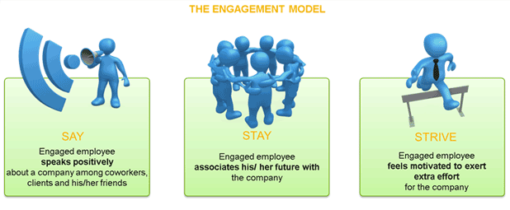

Slide 58
‘Say’ may not = Engagement
Why people who say positive things about their company may not be engaged:
  Core beliefs & values
  Social
  Culture
  Management
  Pride
RAPA 2015 Fall Conference
Notes:
Its my belief that companies are only looking at half the story when measuring employee retention

Slide 59
‘Stay’ may not = Engagement
Why people stay when they are not engaged:
  Benefits
  Close to home
  Hours fit lifestyle
  Would have to move to get an equivalent job
  Seniority
  Comfort
  Responsibility
RAPA 2015 Fall Conference

Slide 60

Strive: Best Indication of Engagement

Slide 61
How to Attract Strivers
Organizational Health Check
  Culture
  Pay & Benefits
  Quality of Team – Strivers like Strivers
  Development Opportunities
If you do not manage culture, it manages you, and you may not even be aware of the extent to which this is happening

Slide 62
How to Select Strivers
Recruiting
  Accomplishments trump experience
  Test them
  Non-work accomplishments
  Those who believe they can do something and those who believe they can't are both right.
  - Henry Ford
RAPA Fall Conference

Slide 63

How to Keep Strivers
Leadership Matters

Slide 64

How to Keep Strivers
#1 Meaningful Work

Slide 65
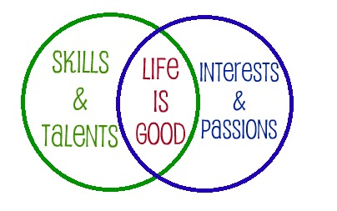
How to Keep Strivers

Slide 66
Tracking Engagement
  Say – employee surveys
  Stay – turnover statistics
  Strive
    You can name them
    Plot your organization
    Track and increase your percentage
RAPA 2015 Fall Conference

Slide 67

Now Go Unleash It!
RAPA 2015 Fall Conference

Slide 68
Emerging Trends:
What Are People Talking About?
Stephen Cooley
Chief Administrative Officer

Slide 69
Topics to cover
What’s In The Cloud?
What The Heck Is Cyber-Insurance?
Predictive Modeling – What is it?
Wearable Technology – A New Fashion Trend?
Marijuana – Smoker or Non-Smoker?

Slide 70
What’s in the Cloud?

Slide 71
The Cloud
National Institute of Standards and Technology US Department of Commerce September 2011
Cloud computing is a model for enabling ubiquitous, convenient, on-demand network access to a shared pool of configurable computing resources (e.g., networks, servers, storage, applications, and services) that can be rapidly provisioned and released with minimal management effort or service provider interaction. This cloud model is composed of five essential characteristics, three service models, and four deployment models.
csrc.nist.gov/publications/nistpubs/800-145/SP800-145.pdf

Slide 72
The Cloud
Essential Characteristics
On-demand self service
  Once set up human intervention is not required
Broad network access
  Available through multiple platforms – mobile phones, tablets, laptops, workstations
Resource pooling
  Storage, processing, memory, bandwidth
Rapid elasticity
  Scale outward and inward on demand
Measured service
  Usage can be monitored, controlled and reported

Slide 73
The Cloud
Service Models
Software as a Service (SaaS)
  Access to the providers applications in a cloud
  GoToMeeting, Google Apps
Platform as a Service (PaaS)
  Customer deploys and manages their services and tools to cloud
  Cloud has underlying infrastructure that the customer does not manage
  Apprenda, Google App Engine
Infrastructure as a Service (IaaS)
  Customers entire network is in a cloud
  Customer manages applications and data
  Amazon Web Services, Google Compute Engine

Slide 74
The Cloud
Deployment Models
Private cloud
  Used by single organization
  Owned by customer or third party
Community cloud
  Used by organizations with similar needs
  Owned by some or all in the community or third party
Public cloud
  Open for use by the general public
Hybrid cloud
  Combination of two or three of Private, Community and Public clouds
  Different clouds used for different data needs

Slide 75
The Cloud
What are the advantages:
Reduced capital expenditures and operational overhead
  Hardware
  Software
  Physical data rooms
Business flexibility
  Can grow or contract depending on circumstances
Easier access to new technology

Slide 76
The Cloud
NAIC
Principles for Effective Cybersecurity
  “…a minimum set of cybersecurity standards must be in place for all insurers…that are physically connected to the Internet and/or other public data networks…”
OSFI
OSFI Guideline B-10 – Outsourcing of Business Activities, Functions and Processes
Concerns with:
  Confidentiality, security & separation of property
  Contingency planning
  Location of records
  Access & audit rights

Slide 77
What the Heck is Cyber-Insurance?

Slide 78
Cyber-Insurance
Insurance products to protect individual users and businesses from internet based risks.
Part of a companies cyber security protection.
The concept of cyber insurance has been around for 20+ years but recently gaining in popularity.
Regulators focusing on cyber security mitigation and cyber insurance growing with this.

Slide 79
Cyber-Insurance
Cyber Security Events
  Anthem – 80,000,000 records
    2nd largest health care insurer
    Names, DOB’s, SSN, addresses, email, phone numbers, employment info
  Home Depot – 56,000,000
    Malware installed on cash register system across 2200 stores
    Possible Russian or Ukrainian hackers responsible for other data breeches
  IRS – 100,000
    “Unnamed cybermafia” used IRS app to download forms full of personal information to claim tax refunds
    Blamed on poor cyber security at the IRS
  EBay – 145,000,000
    Log in credentials obtained from a “small number of employees”
    Using credentials accessed a database containing all user records and “copied a large part of those credentials”
    www.informationisbeautiful.net/visualizations/worlds-biggest-data-breaches-hacks/

Slide 80
Cyber-Insurance
What type of events are covered:
  Cyber liability – if your company is sued by a third party
  Privacy Notification – due to a privacy breach you have to notify customers
  Crisis Management Expenses – public relations cost to manage your company reputation
  E-Business Interruption – if your company is shut down due to a cyber event
  E-Threat Expense – extortion from a third party hack
  E-Vandalism Expense – your website is defaced
Source - Chubb

Slide 81
Cyber-Insurance
Where is cyber-insurance going?
  ~50 insurers writing cyber coverage, but market dominated by 5 underwriters – ACE, AIG, Beazley, Chubb and Zurich
  In 2014 Lloyd’s estimated premium volume estimated to be $2.5B with 90% of the risks written in the US.
  Pricing challenges
    No actuarial data available
    Frequency and severity is unpredictable
    Cyber attacks have unpredictable human behaviors
    Insufficient disclosure data on actual attacks
  No doubt that this is a growing market
Source – Business Insurance June 10/15
http://www.businessinsurance.com/article/20150610/NEWS06/150619981

Slide 82
Predictive Modeling: What is it?

Slide 83
Predictive Modeling
Predictive models are analytical tools to predict the probability of an outcome or future behavior
Used in the P&C industry for many years
Used in disability claims “scoring” for 10+ years
Why is it not used more in underwriting?
  Industry conservative and slow to change
  Results take many years to become apparent
  But things are changing……

Slide 84
Predictive Modeling
What’s changing:
Aging distribution channel
Underwriting process more frustrating than ever
Some consumers looking for “instant gratification”
Companies looking to close gap in “missed” sales
We have the technology

Slide 85
Predictive Modeling
Underwriting the “old” way:
Underwriting - art vs. science
Identifying the minority of unhealthy applicants
Application, exam, fluid testing, more testing….
Following the underwriting manual
Introduction of some predictive tools
The decision can usually be explained (for the most part)

Slide 86
Predictive Models
Advantages:
Can replace the traditional sales process
Access to new sales opportunities
Fewer (if any) invasive tests
Speed to issue
Reduce human error
Takes advantage of technology
Changes can be made “on the fly”

Slide 87
Predictive Models
Disadvantages:
Will your underwriters buy in?
Black box approach
How do you get comfortable with the output?
How do you explain adverse decisions?
Years before you know if you got it right
Can you use all of the tools in real time?

Slide 88
Predictive Models
Rx Databases
Predictive model plus traditional underwriting
Use as a screening tool to supplement other underwriting evidence
A check against non-disclosure
Identify disease based on prescription history
Identify drug interactions
Determine if drug(s) being taken as prescribed

Slide 89
Predictive Models
Lab Scoring
Predictive model to produce final underwriting action.
Uses lab results, build and blood pressure to produce a result.
Final action can be made or kick-out to the traditional underwriting stream.
How do you validate the outcome?
How do you explain an adverse underwriting action on a “normal” blood profile?

Slide 90
Wearable Technology: A new fashion trend?

Slide 91



Wearable Technology
A Brief History:
1975 – Pulsar Calculator watch
1979 – Sony Walkman
1993 – Apple Newton PDA
1999 – BlackBerry
2000 – Bluetooth
2001 – Apple iPod
2004 – GoPro Camera
2008 – FitBit
2011 – Jawbone Up
2012 – Nike FuelBand

Slide 92
Wearable Technology
Medical Devices
AiQ Smart Clothing
  T-shirt that can measure heart rate, respiration rate and skin temperature
BodyTel
  Monitor blood glucose, blood pressure and weight
Nuubo
  Remote cardiac monitoring
Preventice
  Chest sensor collects data on heart rate, respiration rate, activity level and mobile ECG
Moticon
  Wireless shoe insole to measure distribution and motion.

Slide 93

Wearable Technology
Ever hear of Tikker?
“The Tikker watch counts down your estimated life expectancy – you make very second count”
Fill out questionnaire about health history
Asks about exercise, alcohol & tobacco
The countdown starts…..

Slide 94
Wearable Technology
What does wearable technology mean to our industry?
  Promotion of healthy lifestyle
    John Hancock
      Track activity – earn Vitality points
      Given FitBit
    Discovery
      Track activity – earn Vitality points
      FitBit, Garmin, Jawbone and other devices can be used to earn points
  Wearable technology and predictive modeling
  Does the consumer now know “too much” about themselves?
    Is there an anti-selection risk
  What does the future bring?

Slide 95
Marijuana – Smoker or Non-Smoker

Slide 96
Marijuana
Legal Status
U.S.
  27 states have either decriminalized or legalized Marijuana use in some form.
  Alaska, Colorado, Oregon, Washington and the District of Columbia allow recreational use.
  Recreational initiatives expected on 2016 ballots in Arizona, California, Maine, Massachusetts and Nevada.
  Conflicts between federal and state laws
    The manufacture, distribution and possession remains a federal crime – state legalization cannot be used as a defence
    Current administration is deferring to the states

Slide 97
Marijuana
Legal Status
Canada
  Medical marijuana - Supreme Court of Canada (June 2015) allowed for all forms of marijuana, not just dried, to be used
  Other than medical marijuana, police and prosecution in all Canadian jurisdictions can bring charges for possession
  The courts in many Canadian provinces do not enforce the laws
  Hot topic in 2015 Federal Election (which is today):
    Conservatives – have imposed harsher sentences while in power; oppose legalization
    Liberals – want legalization
    NDP – decriminalize but not legalize

Slide 98
Marijuana
Life Underwriting Issues
  Past View
    Considered as smokers and then rated for amount/frequency used
  Current View
    Some U.S. insurers offer non-smoker rates to marijuana users
      At least one company offers non-smoker preferred plus with use of 1 x per week or less
      Some companies look at occasional marijuana use similar to occasional cigar use
    None of the large insurers in Canada have moved to non-smoker rates yet
      Concerns with reputation when use is a hot political topic
    Wide view on the harmful effects on marijuana use and how it varies by way ingested
    The reason for use needs to be closely underwritten

Slide 99
THANK YOU

Slide 100

Lunch
Sponsored by

Slide 101
Reinsurance Administration
Professionals Association
(RAPA)
Nominating Committee
Directed by Shaun Downey

Slide 102
Thanks
Tom Hartlett
Kim Langstaff
Susan Whitehead
Stephanie Williams
RAPA 2015 Fall Conference

Slide 103
Nominating Committee
Stephen Cooley
Brian Smith
Shaun Downey
RAPA 2015 Fall Conference

Slide 104
Nominations
Chair – Greg LaRochelle
Vice Chair – Eddie Martinez
Secretary – Genevra Pflaum
Treasurer – Garfield McIntyre
Past Chair – vacant
RAPA 2015 Fall Conference

Slide 105
Roundtable Discussion:
Looking for an Oasis in an Operational Desert
Facilitators
Anthea Cote’ – Munich American Reassurance Company 1 – Kachina 3 & 4
Susan Gonsalves – Pacific Services Canada Ltd. 2 – Apache
Dale Kraus – Canada Life 3 – Exec. Boardroom
Greg LaRochelle – RBC Insurance Company 4 – Navajo
Edgar Martinez – AXA US 5 – Pima
Lynn Martone – Swiss Re 6 – Pueblo

Slide 106

Break
Sponsored by

Slide 107
Roundtable Discussion: Wrap-up Session
Michael Barnett, President & CEO
mL³ Global Life
Jill Dupuis, VP Operations
Pacific Services Canada
Paula Boswell-Beier, SVP, Chief Operations Officer - US Mortality Markets
RGA
Sara Murphy, VP
mL³ Global Life

Slide 108
Adjourn Day 1

Slide 109
RAPA
2015 Fall Meeting
October 20, 2015

Slide 110
Agenda
8:30 – 8:45 Welcome and Agenda Review
8:45 – 9:45 The Future of Data Privacy & Security in Reinsurance and Beyond
                Moderator – Brittany Pratt
                Speakers – Mitch Ocampo, Brian Millman, Markus Stout
9:45 – 10:00 Survey
10:00 – 10:15 Break
10:15 – 10:30 Education Initiative
                Speaker - Dalia Khoury
10:30 – 10:45 Risk Management Initiative
                Speaker - Garfield McIntyre
10:45 – 11:00 Data Initiative
                Speaker - Genevra Pflaum
11:00 – 11:45 Project and Initiative Meetings
11:45 Adjourn
Notes:
110

Slide 111

2016 Conference
Mark your calendar for the 2016 RAPA FALL CONFERENCE
October 16th – 18th, 2016
San Antonio Marriott Riverwalk

Slide 112
Reinsurance Administration
Professionals Association
(RAPA)
The Future of Data Privacy and
Security in Reinsurance and Beyond
Notes:
Welcome everyone to an exciting and riveting session on …

Slide 113
Moderator: Brittainy Pratt, Sr. Consultant, LOGiQ³
Expert Panel:
Brian Millman, Vice President, MIB
Mitch Ocampo, Executive Vice President, TAI
Markus Stout, Head of Software Engineering, Mass General Hospital
Notes:
We have an amazing panel of industry experts to share their experiences and expertise with us with regards to Data Privacy and Security

Slide 114
Data Security
Challenges in the Marketplace
Notes:
Thank you gentleman for joining us today. I wanted to start the discussion by asking for your thoughts on data privacy and security today and the single largest challenge that you see in the marketplace.
Follow up:
Is there a difference between data security and data privacy?
What do insurers and reinsurers need to consider?
Are technology models driving business models to change? And vice versa?

Slide 115
Fraud Detection, Data Privacy & Security
Notes:
BM – MIB has expertise in providing fraud detection services to the insurance industry. Can you share some of your experiences with the group regarding data security / data privacy?

Slide 116
Reinsurance Administration Platform, Data Privacy & Security
Notes:
Mitch, TAI is a core platform for many insurers when it comes to reinsurance administration and self-reporting to reinsurers. What about your experiences? How is TAI working to address these challenges?

Slide 117
Healthcare, HIPAA, Data Privacy & Security
Notes:
Markus, as the non-industry speaker today, what can you share about data privacy and security in healthcare? How does your experience with HIPAA help us?

Slide 118
Technology :
Mobile Devices, Cloud & Big Data
Notes:
Technology is a very broad topic, and most people here are focused on reinsurance business. To the panel, can you provide some insight on the different aspects of technology that are forcing change? Namely, mobile devices, cloud, and big data? Are there any others? Social media?

Slide 119
User Rights
Notes:
What about user rights? What should the audience consider to ensure they have a safe and secure environment when they are dealing with PII data?
TAI?
MIB?
Markus, any thoughts?

Slide 120
Data Collection & Distribution
Notes:
What about data collection / distribution inside and outside the company? For example, when sending claims, billing history from ceding company to reinsurer?

Slide 121
Legal Environment
Notes:
There are numerous laws that govern how both insurers and vendors can do business. What laws have the largest impact on your respective organizations?
Are there any new regulatory changes that are on the horizon?

Slide 122
Best Practices
Notes:
So, what are some best practices we can take away today and start immediately in our organizations?
What things we as insurers / reinsurers should avoid?

Slide 123
Best Practices
Share data securely
Don’t give away confidential information
Don’t leave sensitive information lying around the office
Lock your computer
Be cautious of suspicious links
Don’t install unauthorized programs at work
Report suspicious or unauthorized access
Security Awareness Program
Don’t forget physical security
Manage removable devices
Keep software up to date
Notes:
So, what are some best practices we can take away today and start immediately in our organizations?
What things we as insurers / reinsurers should avoid?

Slide 124
Questions
Notes:
Thank you gentlemen…

Slide 125
Survey
Please take a moment to fill out the survey.
Thanks!

Slide 126
Break

Slide 127
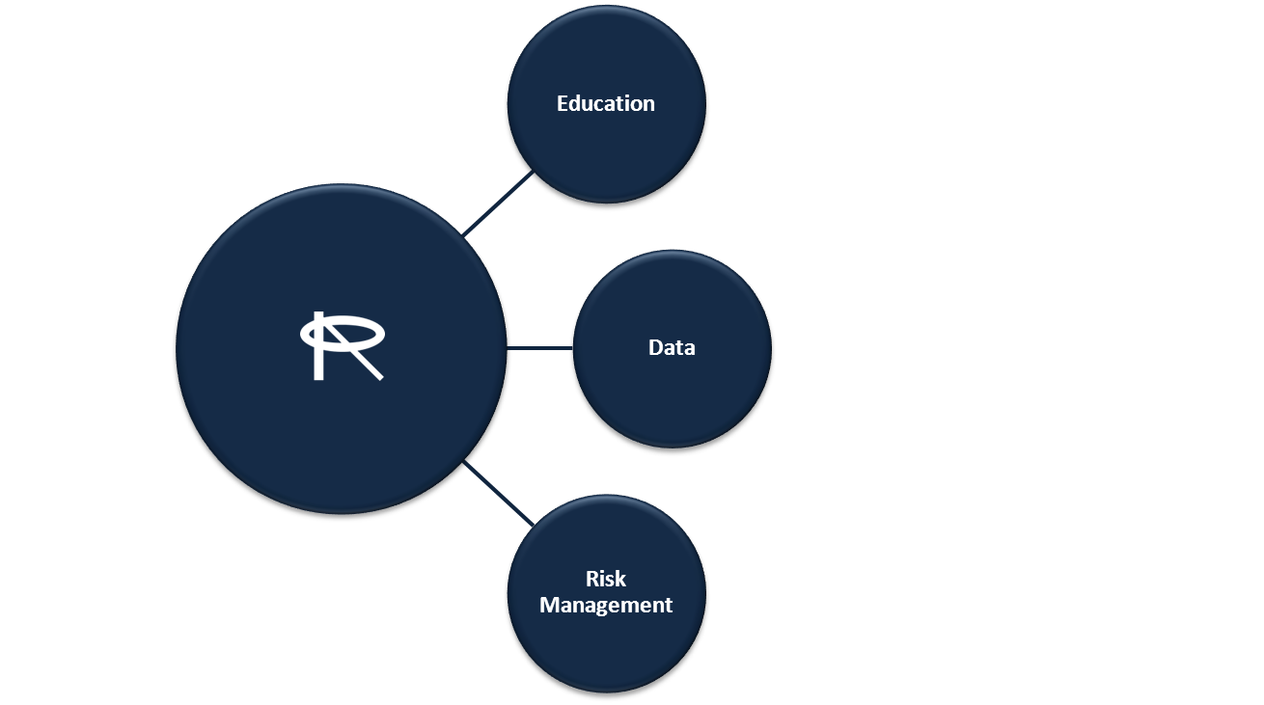
Initiatives Strategy
Purpose: To improve the effectiveness and efficiency of RAPA member's reinsurance understanding and processes. The initiatives work streams provides the opportunity for members to work together on education, training, and to benefit from robust collaboration with industry experts within the working groups.
Thinking of a new initiative?
Submit your suggestion to Greg LaRochelle [greg.larochelle@rbc.com]
Want to join an Initiative? Just contact one of the leads
Education: Dalia Khoury, Optimum Re
Dalia.Khoury@optimumre.com
Data: Genevra Pflaum, Hannover Re
Genevra.Pflaum@hlramerica.com
Risk: Garfield McIntyre, Munich Re
Gmcintyre@munichre.com
Notes:
Per Slide

Slide 128
Education Initiative
Purpose
Develop training material presented as a workflow chart for different processing functions and ultimately have case study to illustrate the impact of processing by using the workflow charts.
Deliverables & Milestones
We have 3 sub-groups presenting the 3 different layers:
  Sub Group 1 – Direct (Vivian Tseng)
  Sub Group 2 – Reinsurance (Diana Aversa)
  Sub Group 3 – Retrocessionaire (Pat Ellis)
Notes:
Dalia to speak to

Slide 129
Members
Maribet Toledo, Lincoln Financial
Pat Ellis, RGA
Patty Bailey, Manu Life
Paula Boswell-Beier, RGA
Vivian Tseng, John Hancock
Vu Nguyen, Prudential
Cindy Eason-Manning, RGA
Diane Hare, RGA
Karen Nelms, USAA
Ann Grace, Manu Life
Brenda Warner, Canada Life
Deidre Ward, Swiss re
Diana Aversa, Pac Life
Judy Brillert, Canada Life
Julie Dee Faris, CSC
Kim Brabham, Hannover Re

Slide 130
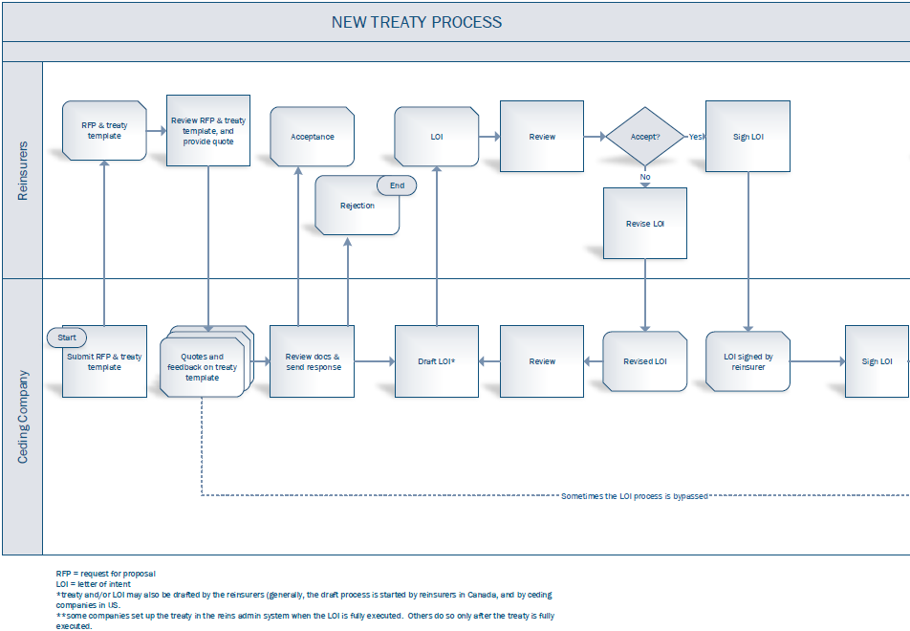
Direct Workflow 1.1 of 2

Slide 131
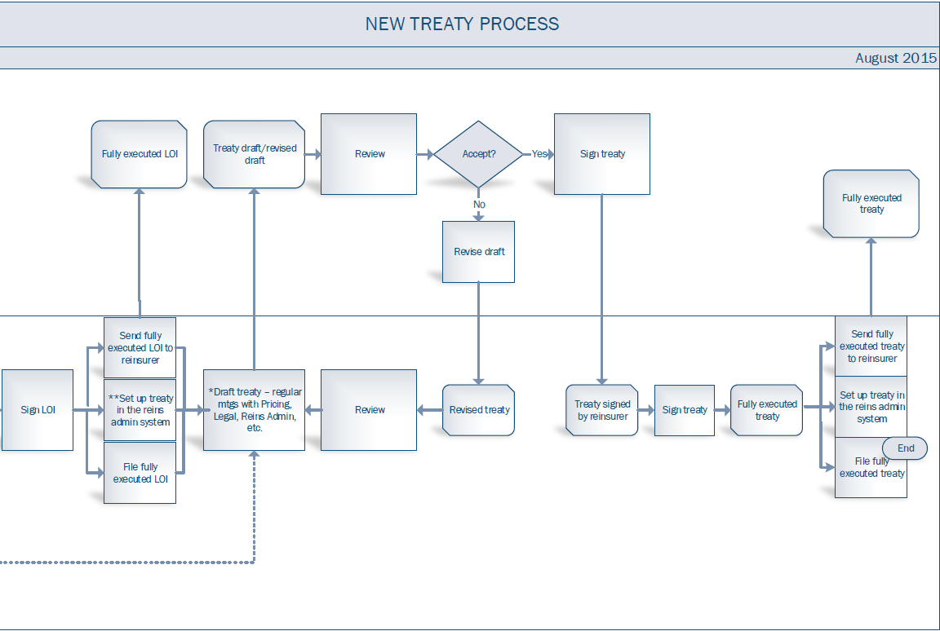
Direct Workflow 1.2 of 2

Slide 132
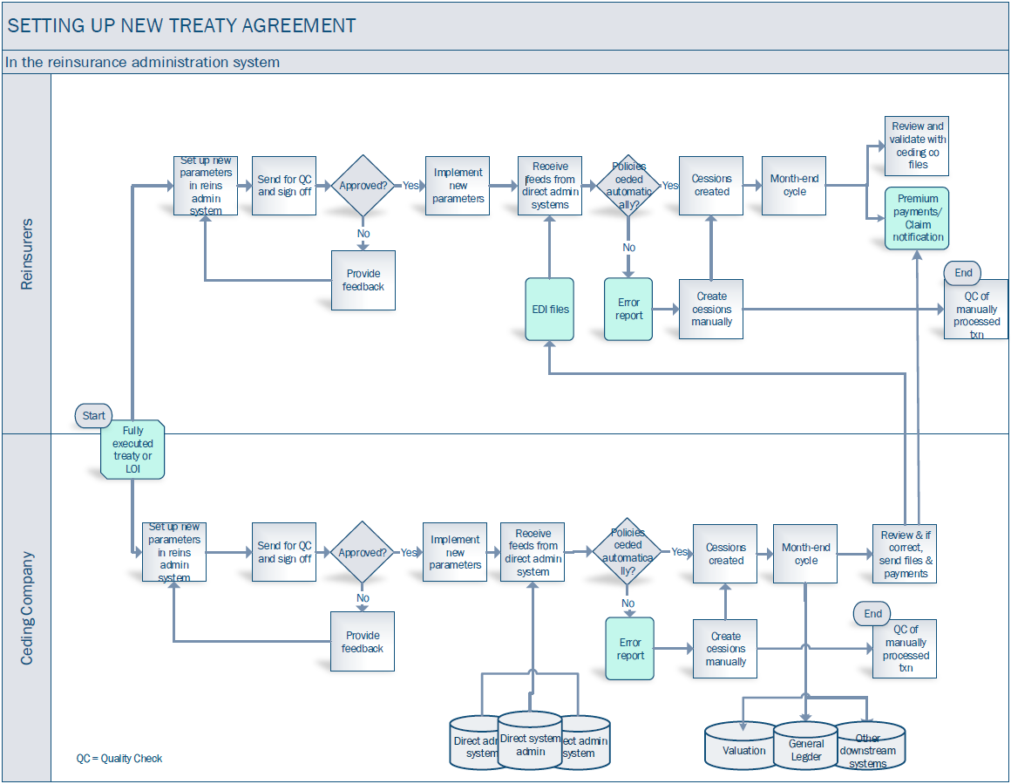
Direct Workflow 2 of 2

Slide 133
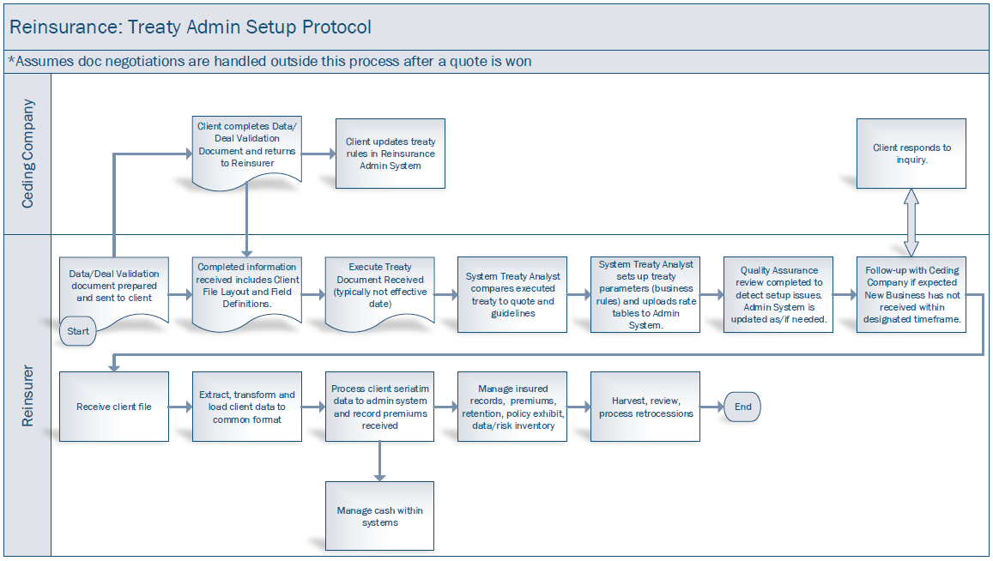
Reinsurance Workflow

Slide 134
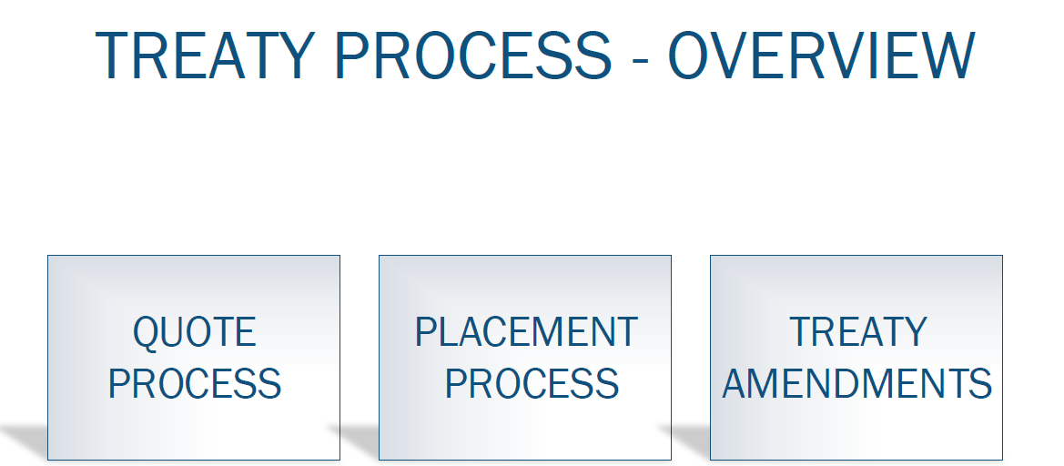
Retrocession WorkFlow 1 of 4

Slide 135
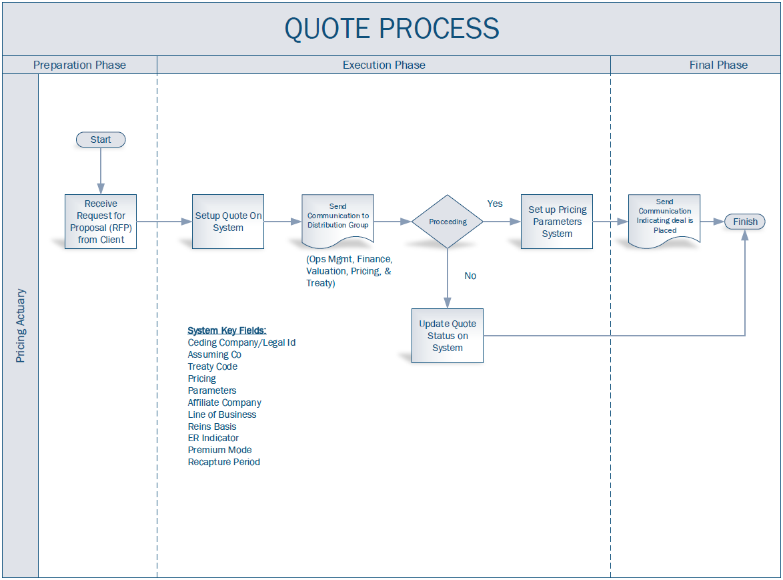
Retrocession WorkFlow 2 of 4

Slide 136
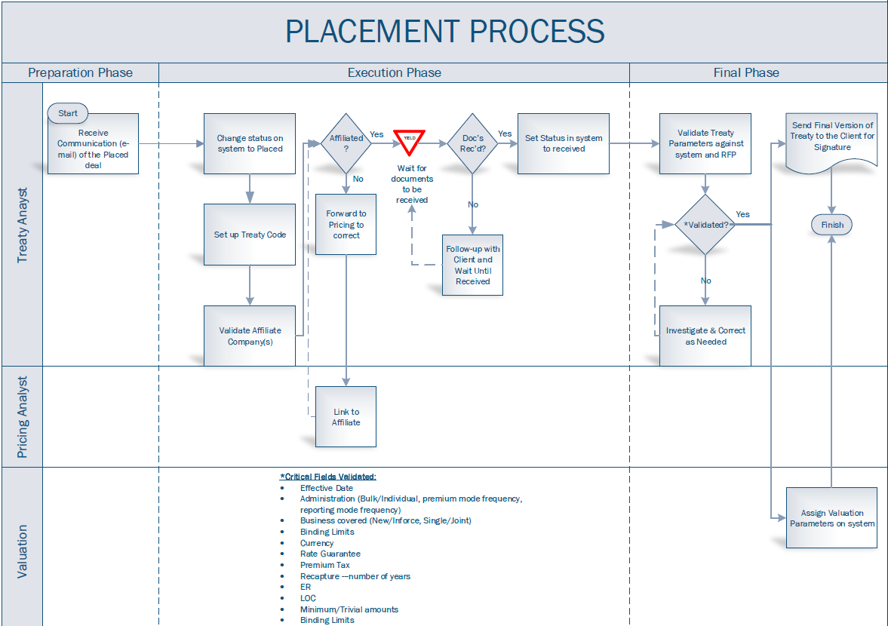
Retrocession WorkFlow 3 of 4

Slide 137
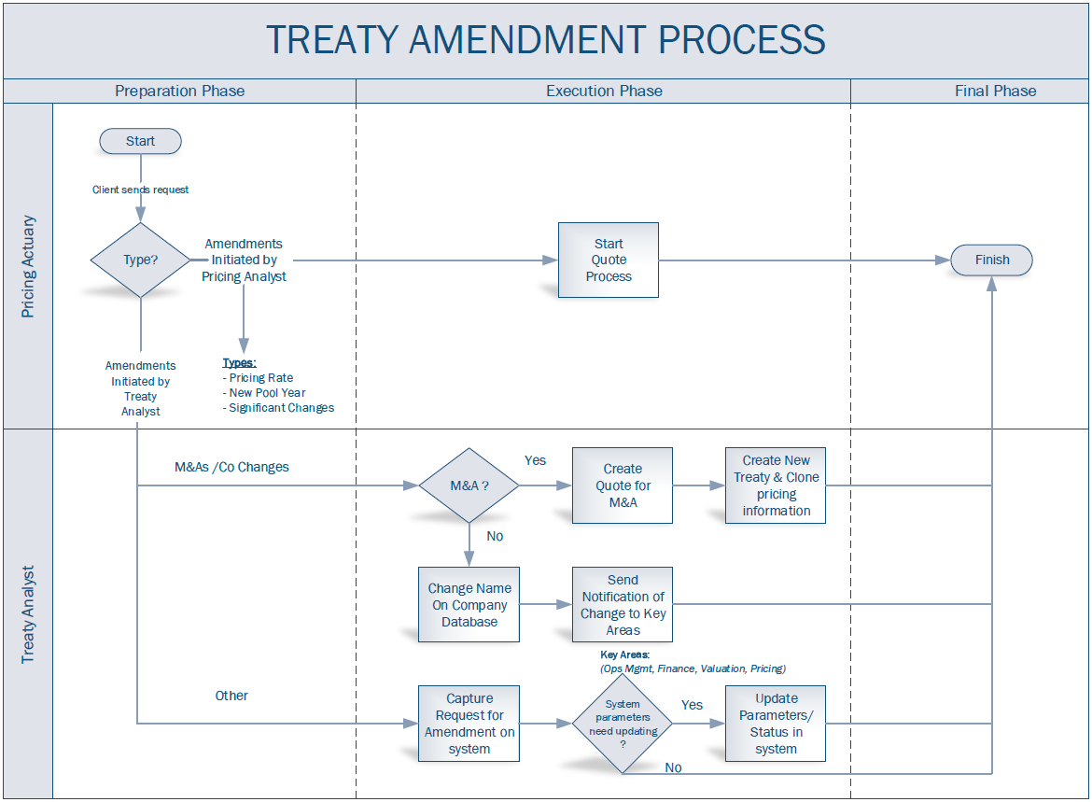
Retrocession WorkFlow 4 of 4

Slide 138
Supplement to Reinsurance Basics
The reinsurance course collection consist of:
  Life Insurance Basics
  Life Insurance Products
  Reinsurance Basics
  Supplement to Reinsurance Basics
We as an industry have a responsibility to endorse educational programs.
  Need your support to promote the LOMA Learn courses along with the commitment to Plan & Budget.
Cost $100 vs $149 for members
LINK: https://www.lomalearn.org/topclass/TopClass.dll?expand-product_id-1002460657
Notes:
Tom to speak to
138

Slide 139
Education Initiative

Slide 140
Next Up:
Audit Initiative Presentation
Garfield McIntyre
Manager, Customer Compliance
Munich American Reassurance Company

Slide 141

RAPA
Risk Management Initiative Update
2015 Fall Conference
October 18 - 20, 2015
Tempe, Arizona

Slide 142
Purpose
To develop tools and techniques to provide guidelines on reinsurance risk management methodology and approaches. Particularly relating to risk identification, assessment, and mitigation.
This initiative is divided into two sub-teams with focus on:
  Reinsurance Administration Risk Identification, Assessment & Mitigation; plus
  Reinsurance Administration Audits and Compliance Reviews.
RAPA 2015 Fall Conference

Slide 143
Deliverables
Areas of focus for 2015:
    Completed an assessment of COSO’s Risk Management Framework and its use for Reinsurance Administration.
    Developed a draft of a risk assessment matrix.
    Assessed and developed RAPA’s risk based audit guidelines document.
    Developing and providing relevant training on risk management tools and techniques.
RAPA 2015 Fall Conference
Notes:
Provide a brief overview of the Risk Assessment Matrix and Risk Based Audit Guidelines documents, and provide reference to links on RAPA’s website.
The Risk Management Initiative deliverables can be accessed from the http://reinsadmin.org/initiatives/ webpage.

Slide 144
Potential Next Steps
Likely next steps for 2016 include:
    Continue to develop the draft risk assessment matrix.
    Assess and develop risk management dashboards and KPI.
    Develop and provide training on risk management tools and techniques; plus auditing/compliance methodology.
    Other initiatives as determine by the team.
RAPA 2015 Fall Conference
Notes:
KPI – Key Performance Indicators/Matrixes.

Slide 145
Team Members
Risk Management | Audit/Compliance
Laurie Barrett, Amica | Jennifer Atlee, Hannover Re
Barbara Beicker, USAA | Laura D’andrea, Prudential
Isabelle Calderon, Gen Re | Sophie Lajeunesse, Munich Re
Anthea Cote, Munich Re | Garfield McIntyre, Munich Re
Amalia Figueiras, Prudential | Ricky Peterson, Munich Re
Sandra Law, Score | John Whitaker, RGA Re
Lynn Martone, Swiss Re
Garfield McIntyre, Munich Re
Shawn Murphy, Swiss Re
Kelly Priest, LOGIQ³
Additional volunteers are welcome to join this group!!
RAPA 2015 Fall Conference
Notes:
Lynn Martone & Kelly Priest have agreed to co-chair this initiative during 2016.

Slide 146


Q & A
Continued participation in 2016 is needed to develop the deliverables within achievable timelines.
Join our group during the Project & Initiative segment for information on how to get “Plugged In”.
RAPA 2015 Fall Conference

Slide 147
Next Up:
Data Initiative Presentation
Genevra Pflaum
Manager, Client Data Quality
Hannover Life Reassurance Company of America

Slide 148




Data Initiative
Purpose
Create a document of Guidelines for Reinsurance Reporting, in essence a document of best practices for specific areas of reinsurance administration and data quality. The document will include information, samples and realistic scenarios. Topics:
  Reporting Issues
  Communication/Notifications
  Data Quality
  Conversions
  Taking a Treaty from paper to system implementation
  Samples of typical reinsurance reporting, i.e. Policy Exhibit, Transaction files, etc.
Reinsurance Reporting Guidelines & Best Practices

Slide 149
Data Initiative
Deliverables & Milestones
  4 sub groups tackling different topics.
  Delivered Version 1 at 2014 RAPA Fall Meeting
  Delivered Version 2 at 2015 RAPA Spring Meeting
    Partial Reporting
    Policy Number Changes
    Inforce and Transaction not Reconciling
  Version 3 is now available!
    Guidelines for Partial Conversions
    “New Client” Reporting Guidelines and
    Templates
    C. Claims Reporting Guidelines
Reinsurance Reporting Guidelines & Best Practices

Slide 150
Data Initiative
Members
Genevra Pflaum, Hannover Re
  Rhonda Nielsen-Jackson, Hannover
  Evelyn Bradanovich, Pacific Services
  Ellen Fedorowicz, Jackson National
  Rajesh Kavuru, Swiss Re
  Betsy Russell, Munich Re
  Lisa Sher, Scor Re
  Melinda Bynoe, BMO Reinsurance
  Robert McCloskey, RBC insurance
  Par Kambo, RBC Insurance
  Dzan Dinh, Munich Re
  Lynn Martone, Swiss Re
  Laurie Barrett, Amica
  Duane Pfaff, Voya
  Diana Aversa, Pacific Services
  Grace Sirianni, Munich Re
  Eileen Ah-Fat, Canada Life
  Karen Lipka, RGA
  John DeCarlo, Aurigen Re
  Lisa Clarke, Logiq3
  Michael Barnett, mL3 Global Life
Reinsurance Reporting Guidelines & Best Practices

Slide 151
Data Initiative
Roundtable Discussions
March 2015 – Premium Validation
  What areas of a company are doing premium validation
  Set up/storing electronic rates
  Best practices – Communication!
September 2015 – Post Level Term
  Attended by members of all RAPA Initiatives
  Administration challenges
  Lapse/Persistency analysis
  Creative post level term rates
Reinsurance Reporting Guidelines & Best Practices

Slide 152
Data Initiative
RAPA Post Level Term Initiative
1-2 year effort
Create Best Practices or White Paper
Panel presentation at future RAPA Fall Meeting
Need a leader and participants! Anyone?
Reinsurance Reporting Guidelines & Best Practices

Slide 153
Data Initiative
Next steps:
Data Quality Sub Group – Continue work on Glossary of Terms
Collaborate with Education Initiative
Discuss additional items for Best Practices document
Use it!
Communicating System, Data, or Administration Changes to Business Partners
Reinsurance Reporting Guidelines and Best Practices
Reinsurance Reporting Guidelines & Best Practices

Slide 154
Breakout Sessions
  Executive
    Greg LaRochelle
  Planning
    Stephanie Williams
  Data Quality Initiative
    Genevra Pflaum
  Risk Management Initiative
    Garfield McIntyre
  Education Initiative
    Dalia Khoury
Notes:
Tom to speak to
154

