Slide 1
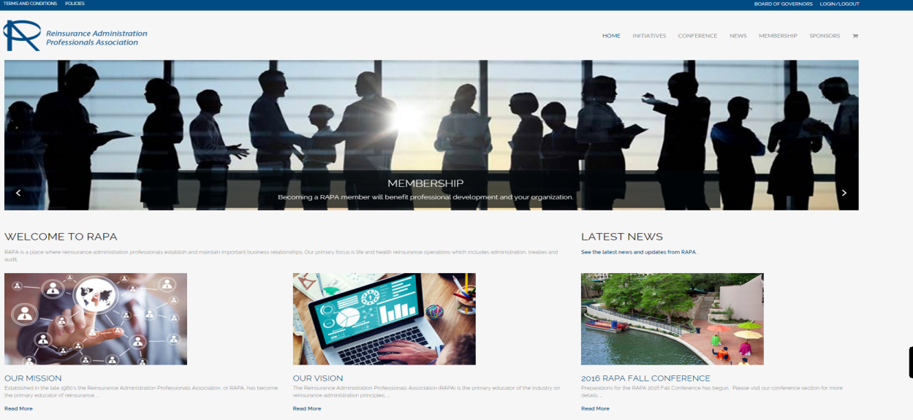
Communication Committee
Website
Content continues to be updated – Whitepapers, SOA, CRC, Newsletters, etc - Check back frequently
General site housekeeping
Increase presence on social media

